Slide 1
Heuristic Evaluation of Fire Emblem Heroes
by Yavor Aldev

Slide 2










Content
1 – Visibility
3 – Freedom
5 – Error Prevention
7 – Flexibility
9 – Error Recovery
2 – Mapping
4 – Consistency
6- Recognition
8 – Minimalism / Aesthetics
10 - Help
11 – Conclusion

Slide 3
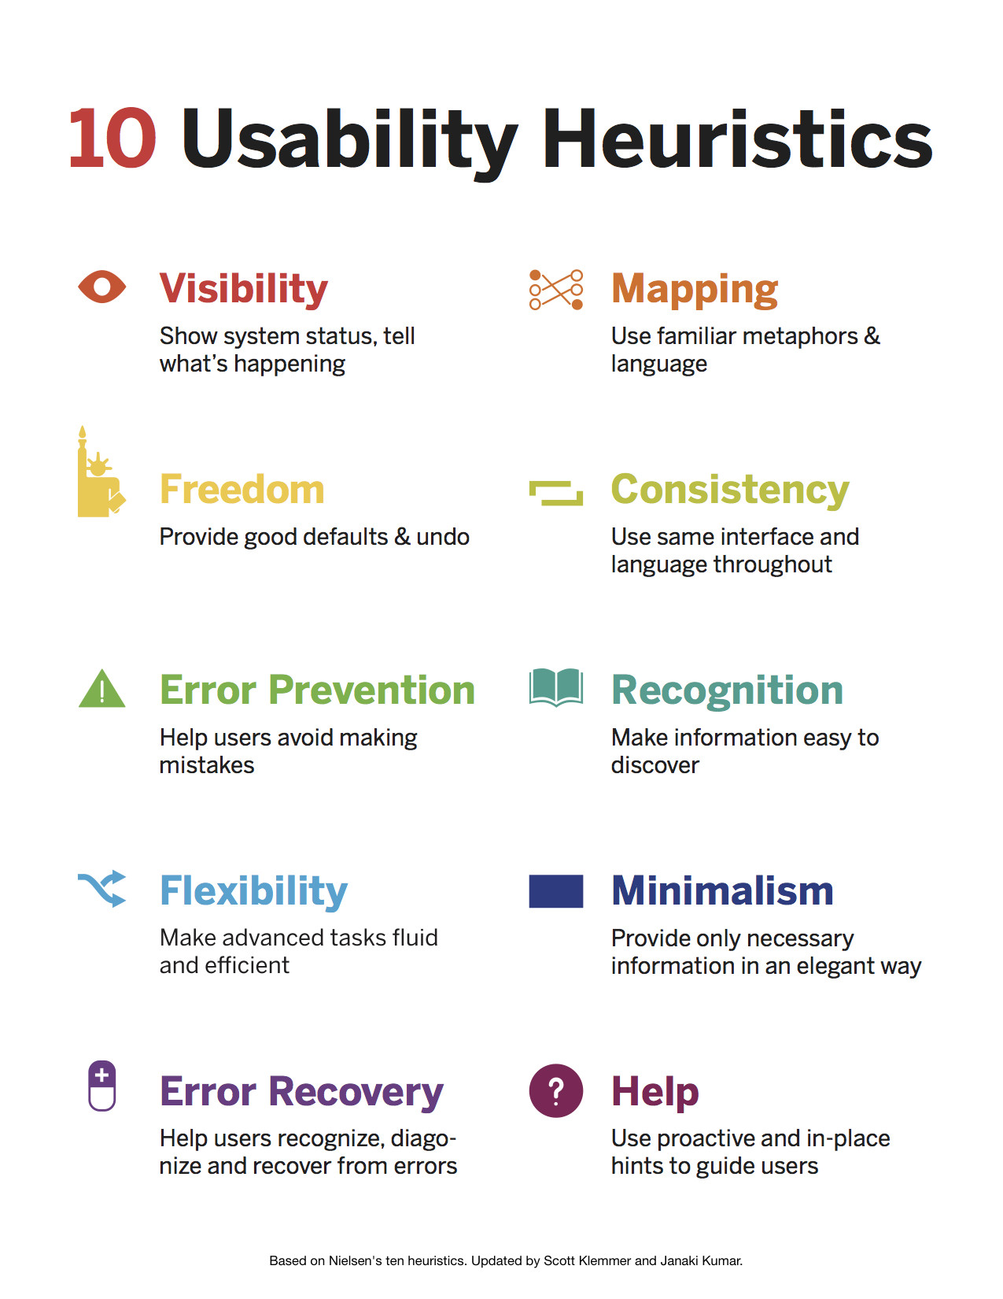
What is a Heuristic Evaluation?
A heuristic evaluation is a usability inspection method for computer software that helps to identify usability problems in the user interface design
It involves a group of evaluators systematically examining the interface based on a set of predefined usability principles or heuristics
The evaluation aims to identify usability issues and provide recommendations for improving the user experience.
Nielsen's 10 usability heuristics are the most-used in interaction design

Slide 4
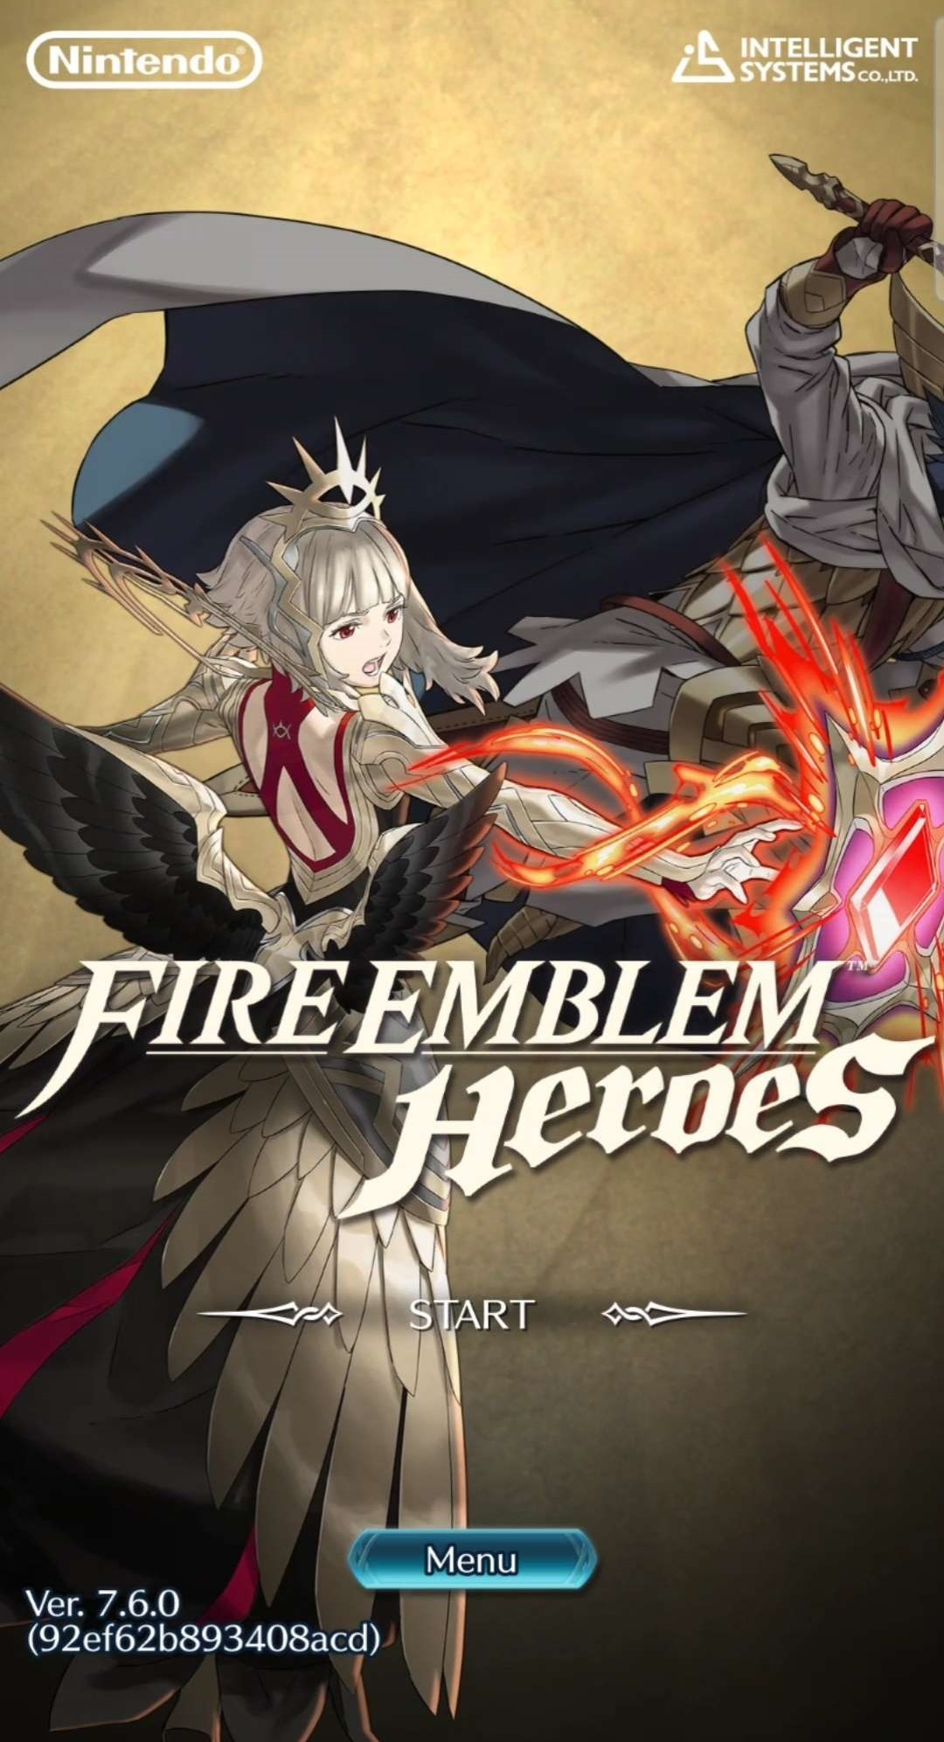
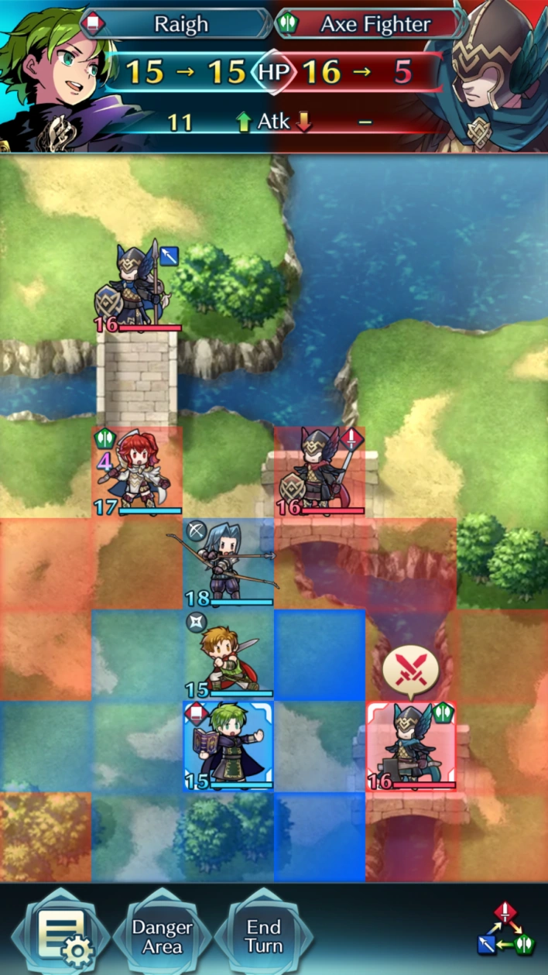
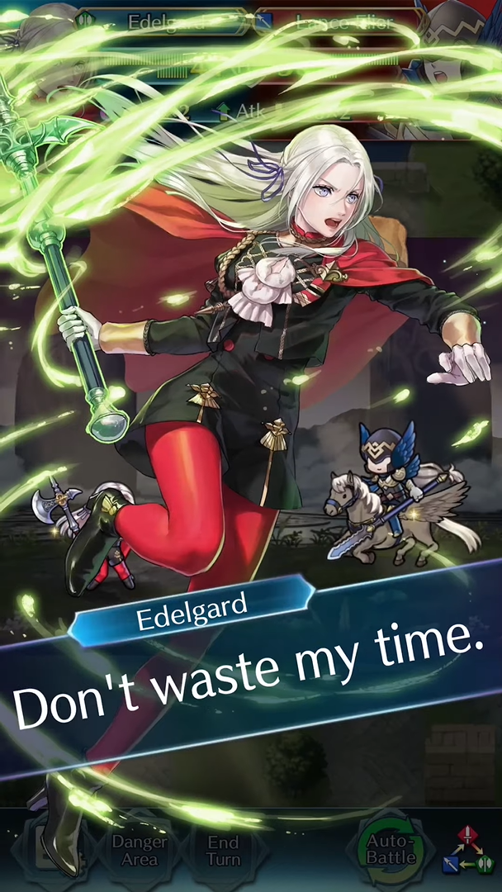
What is Fire Emblem heroes?
Fire Emblem Heroes is a tactical role-playing game for Android and iOS
In this game, you control a team of heroes from the Fire Emblem franchise and fight against enemies in a variety of different game modes
While there is no definitive ending, there are various tasks you could do, such as competitive battles, hero collecting, customizing your characters or just seeing your favorite characters interact with each other!

Slide 5
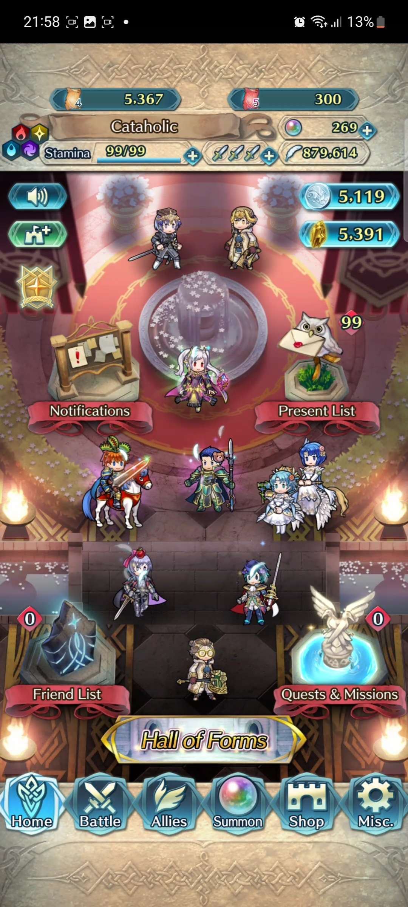

Visibility
When you log into the game, you are placed on your Home Screen, where you can receive different quests and rewards, but more importantly on the bottom there is a menu with a way for you navigate to different aspects of the game
You can always tell what part of the game you're in on the bottom of the screen by the glowing symbol with text
(if there isn't already extra text on the top of the screen already)

Slide 6
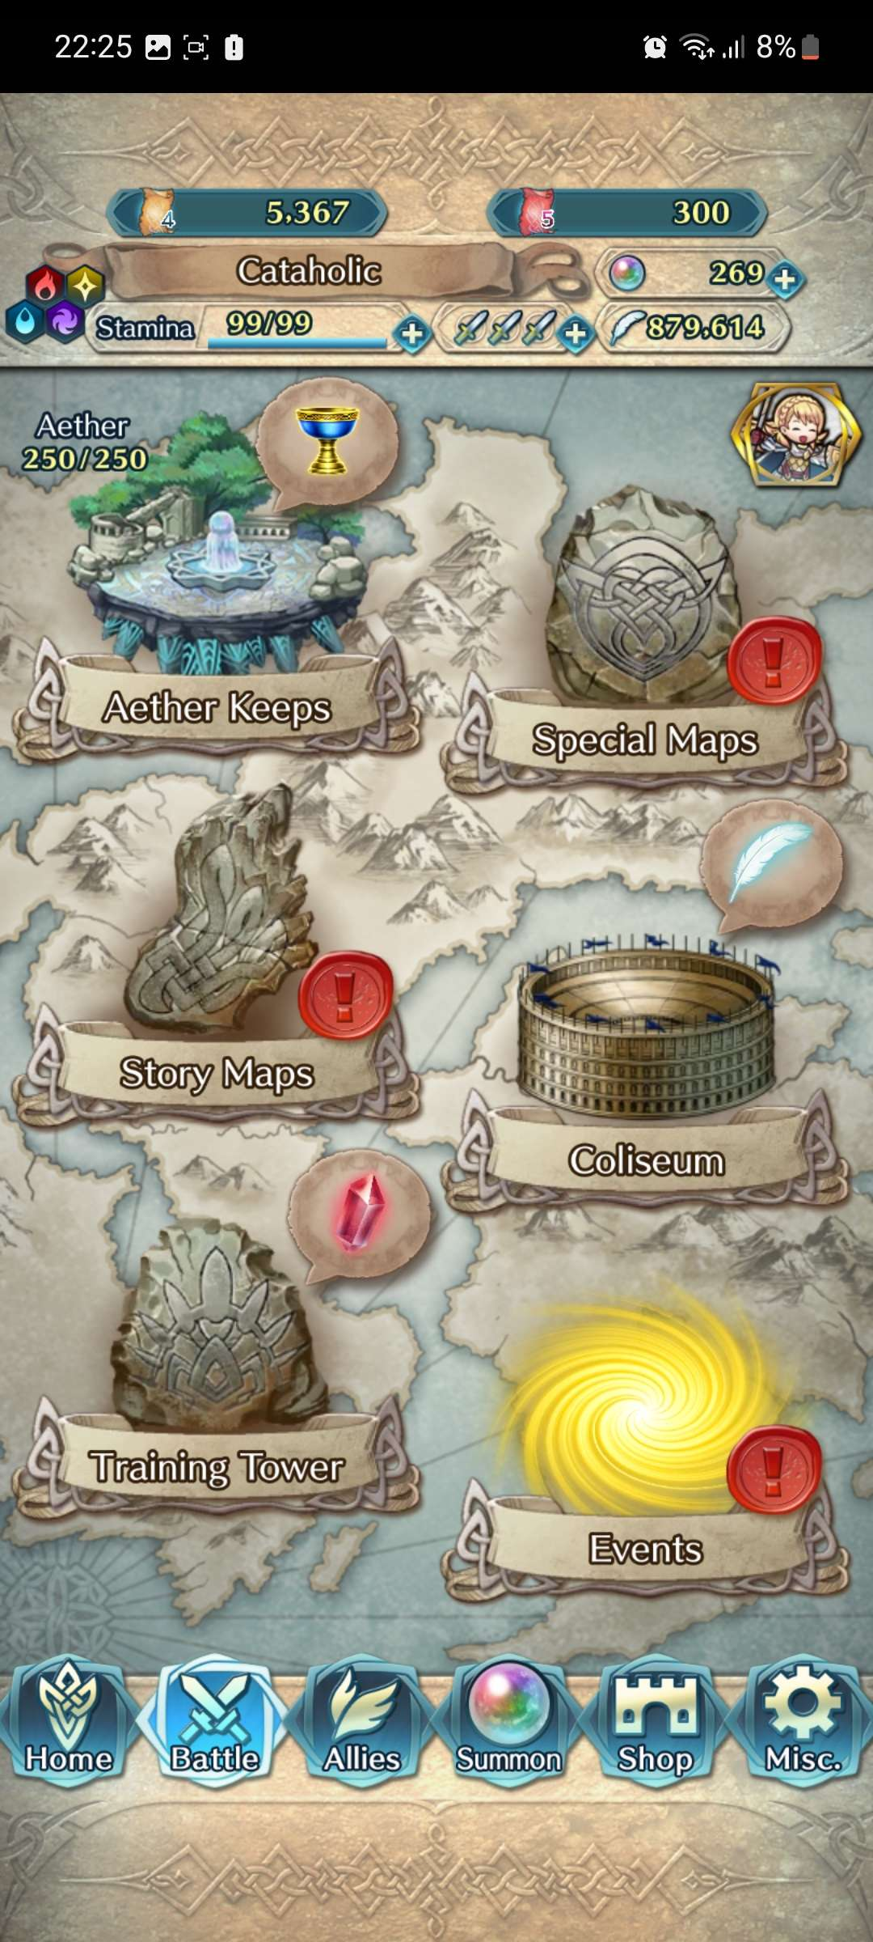
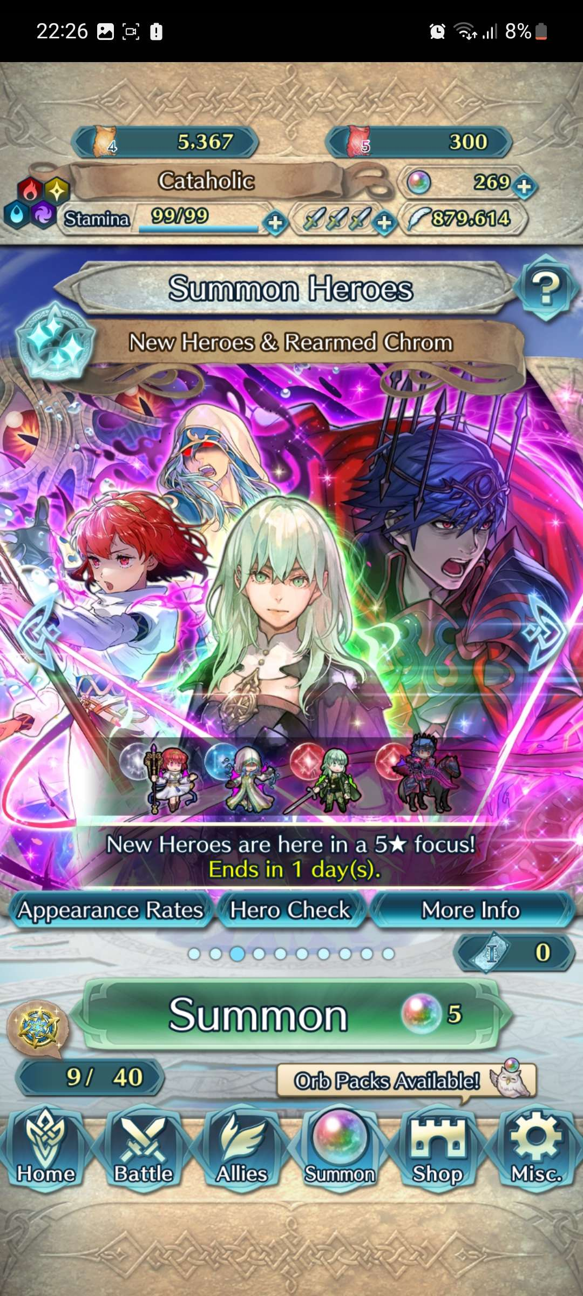




Visibility

Slide 7
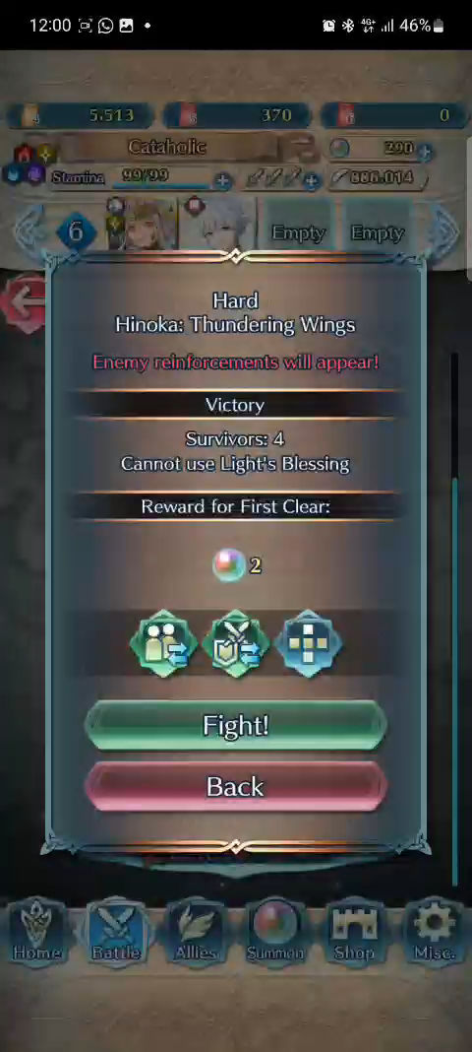

Visibility
Since this is a mobile game designed for a touchscreen, feedback is very important since there is no physical buttons,
so almost everything in the game makes a sound when you touch it, with everything having distinct sounds depending on the context
(like using menus, moving characters, inspecting skills),
It also has a glowing firework visual effect when you click somewhere on the screen, as well as a light trail for when you slide your finger across the screen

Slide 8
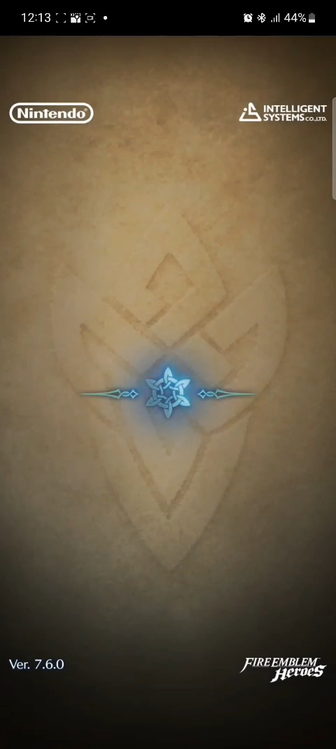
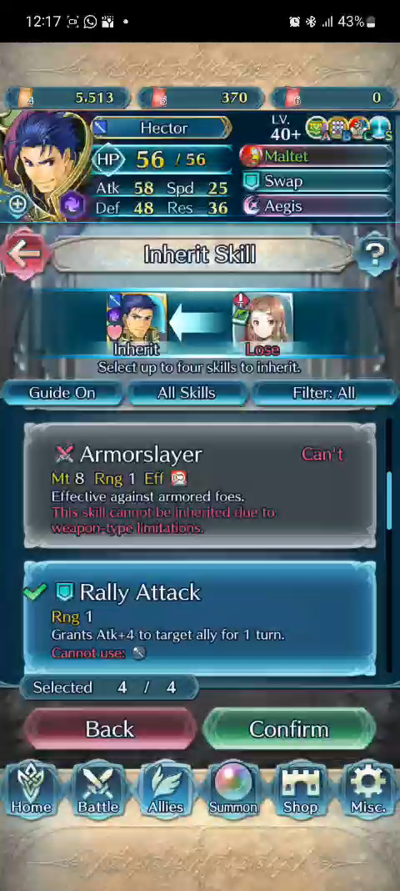
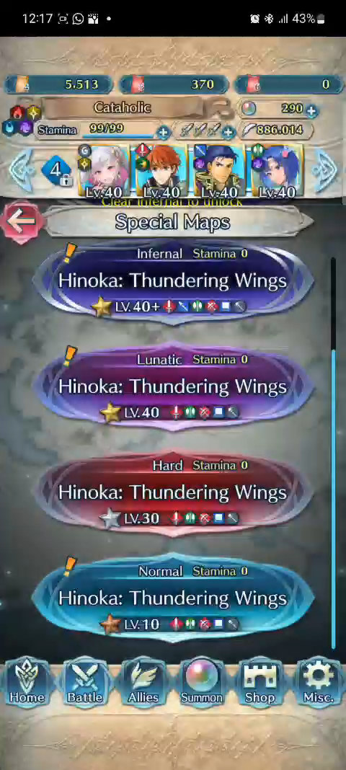
Visibility
To indicate when your phone is connecting to the server, there is a spinning loading icon that shows up when you access different game modes or do some specific tasks like summoning, learning skills and some others
Another important aspect is that this is an always online game, so it makes connections to a game server all the time
*click to play video*
*click to play video*

Slide 9


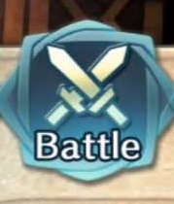
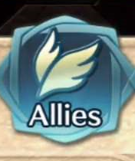
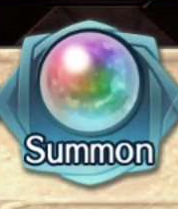

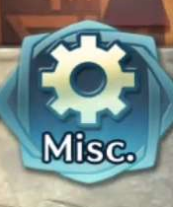
Matching
Crest
The game features a variety of icons, most of which are used for gameplay purposes (informing the player of modifier, effects, etc), but there are also icons to help with navigation
Swords
Feathers
All the options on the navigation bar have an icon associated with them
Orb
And while some are appropriate, others are confusing
(what is the connection between a feather and allies?
and what do castles have to do with shops??)
Castle
Gear

Slide 10
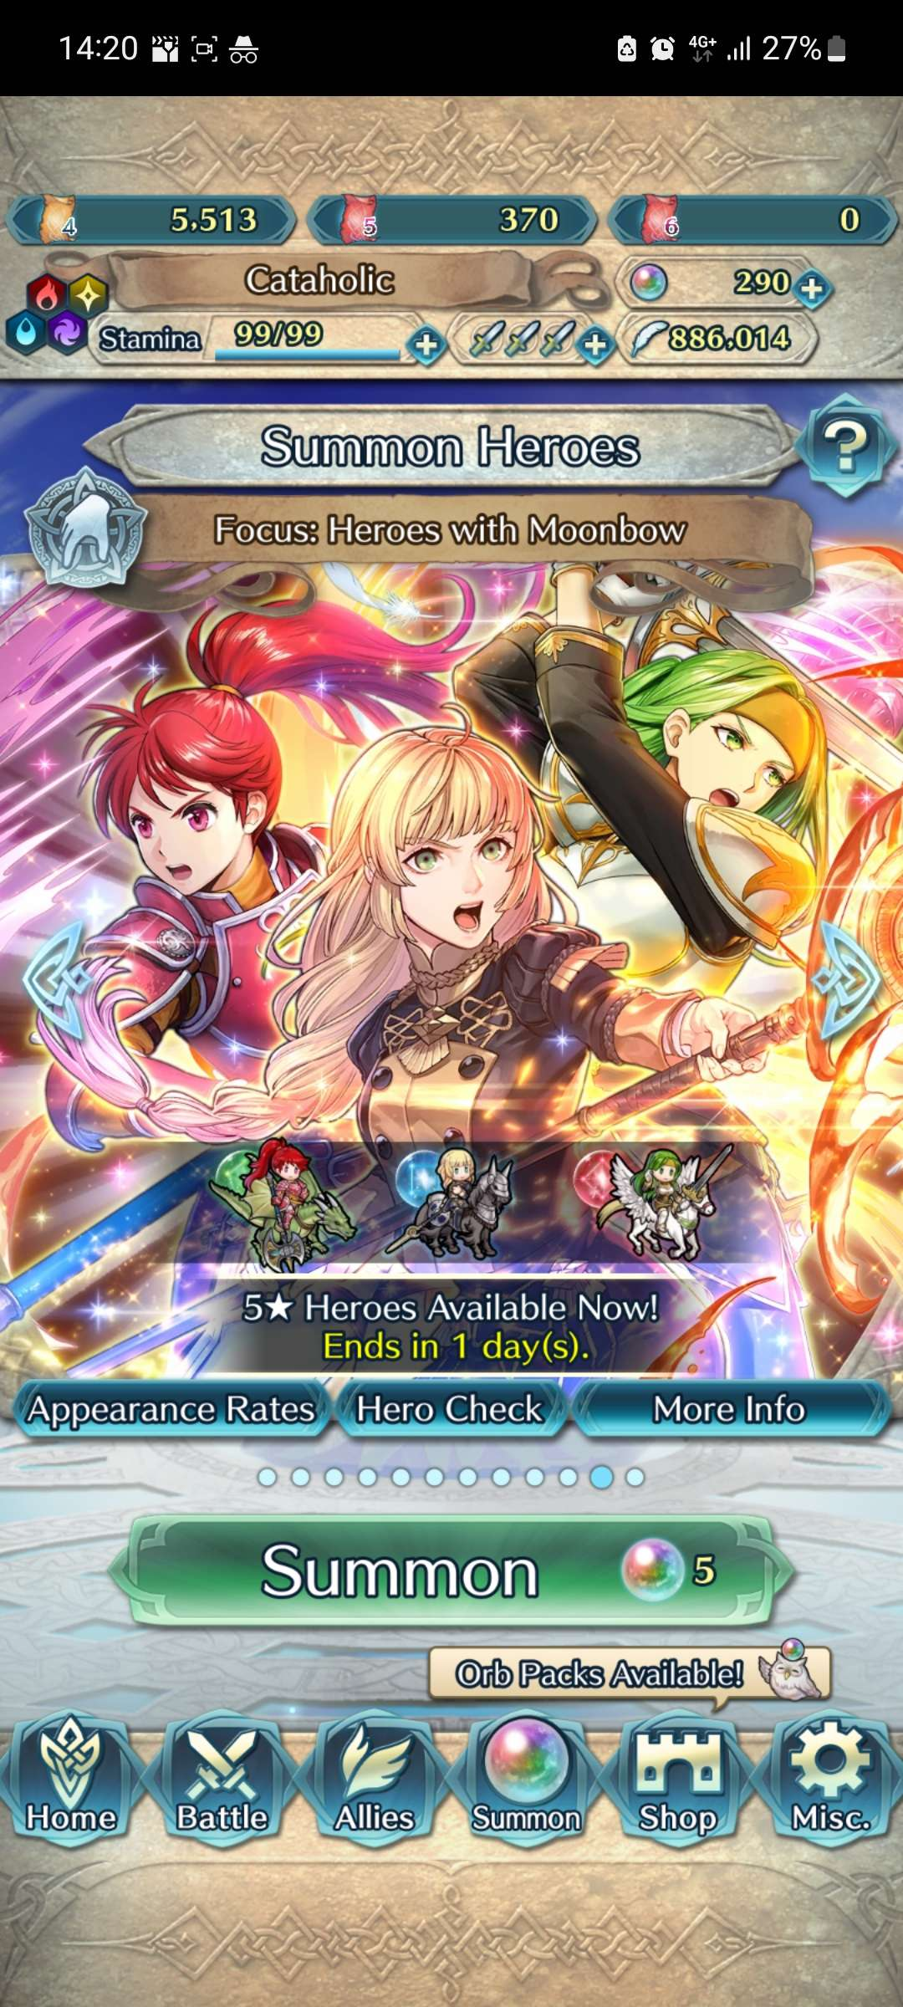

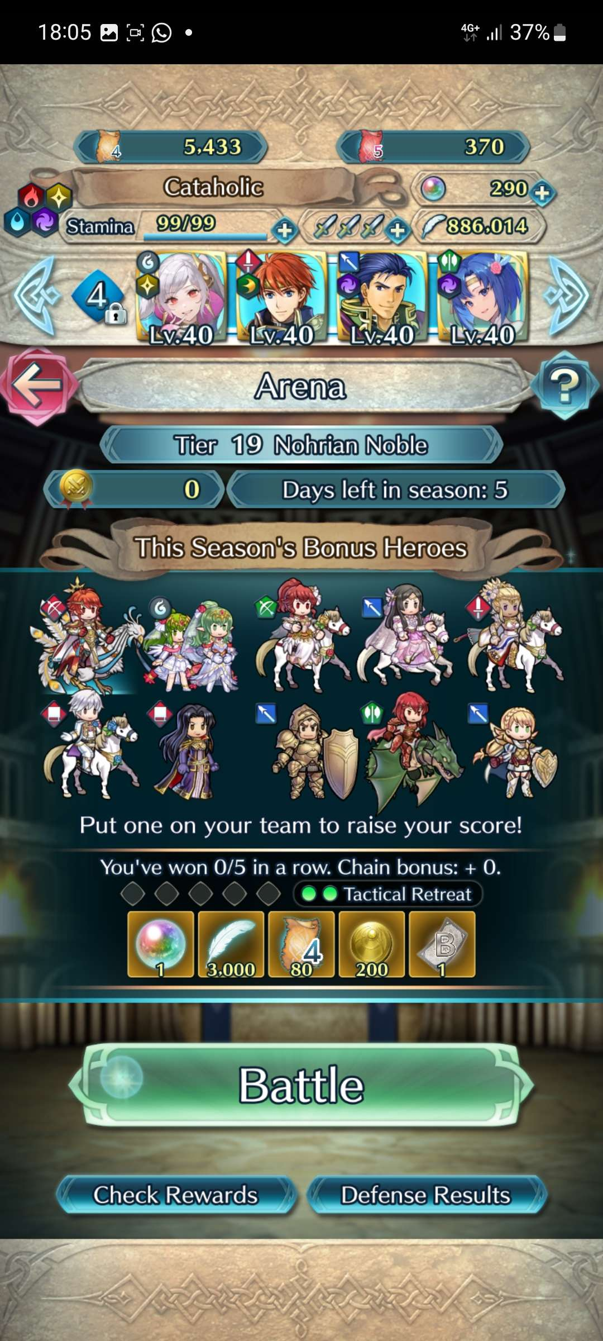
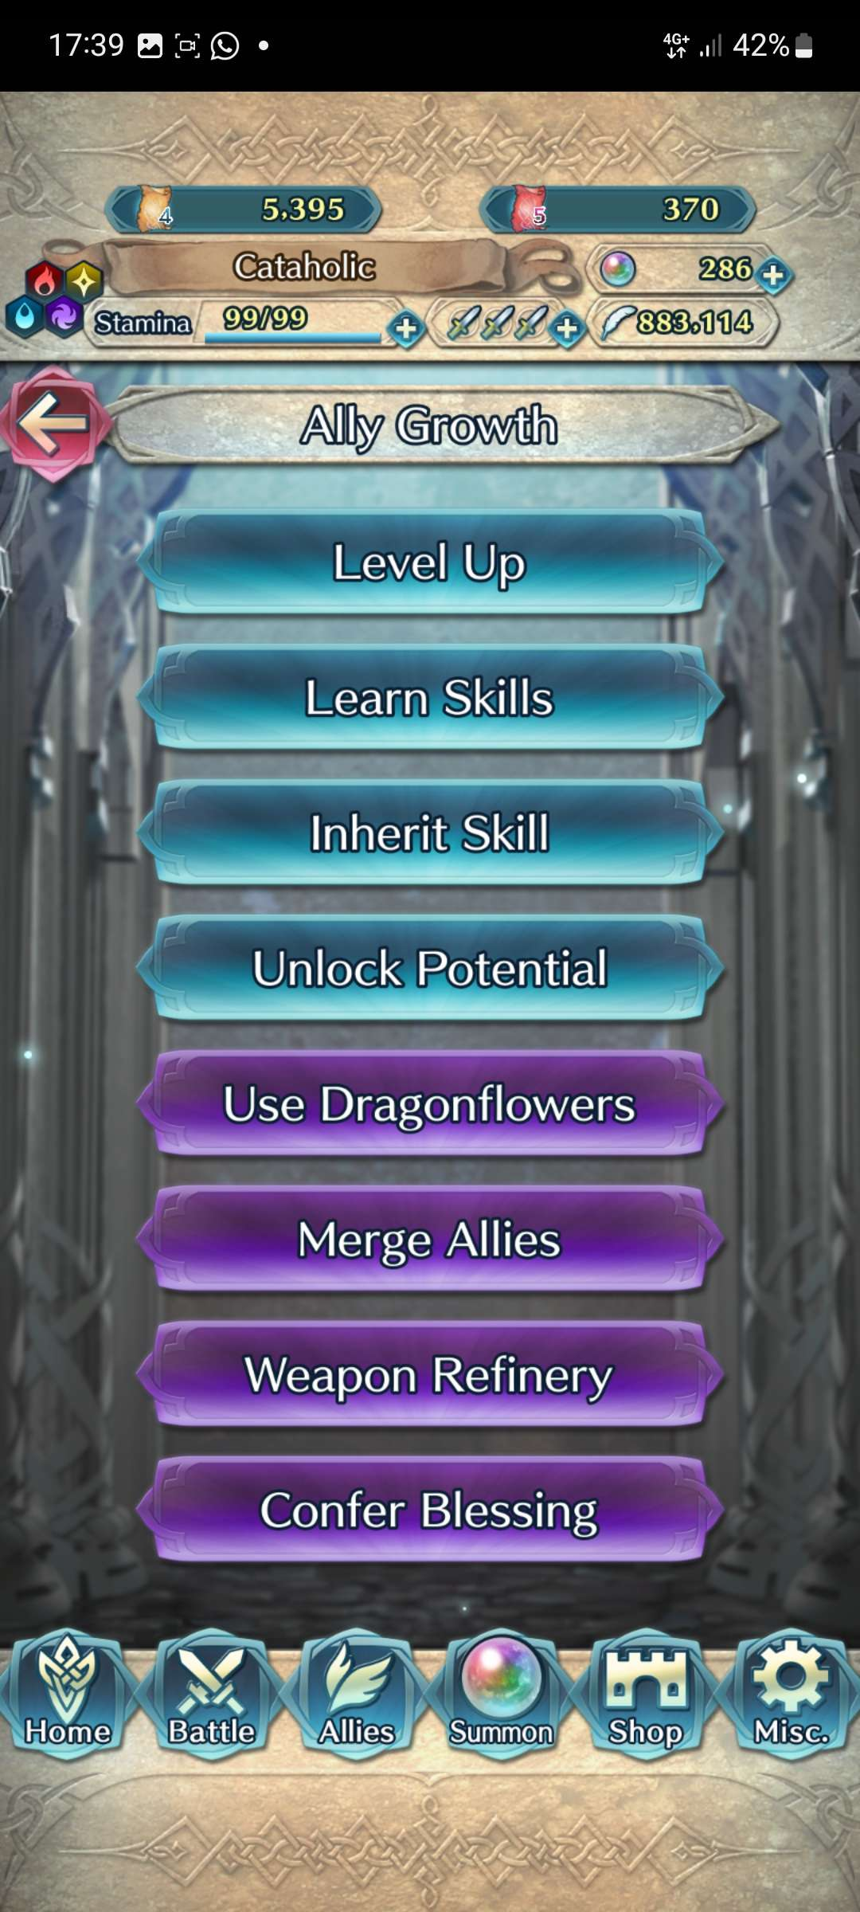
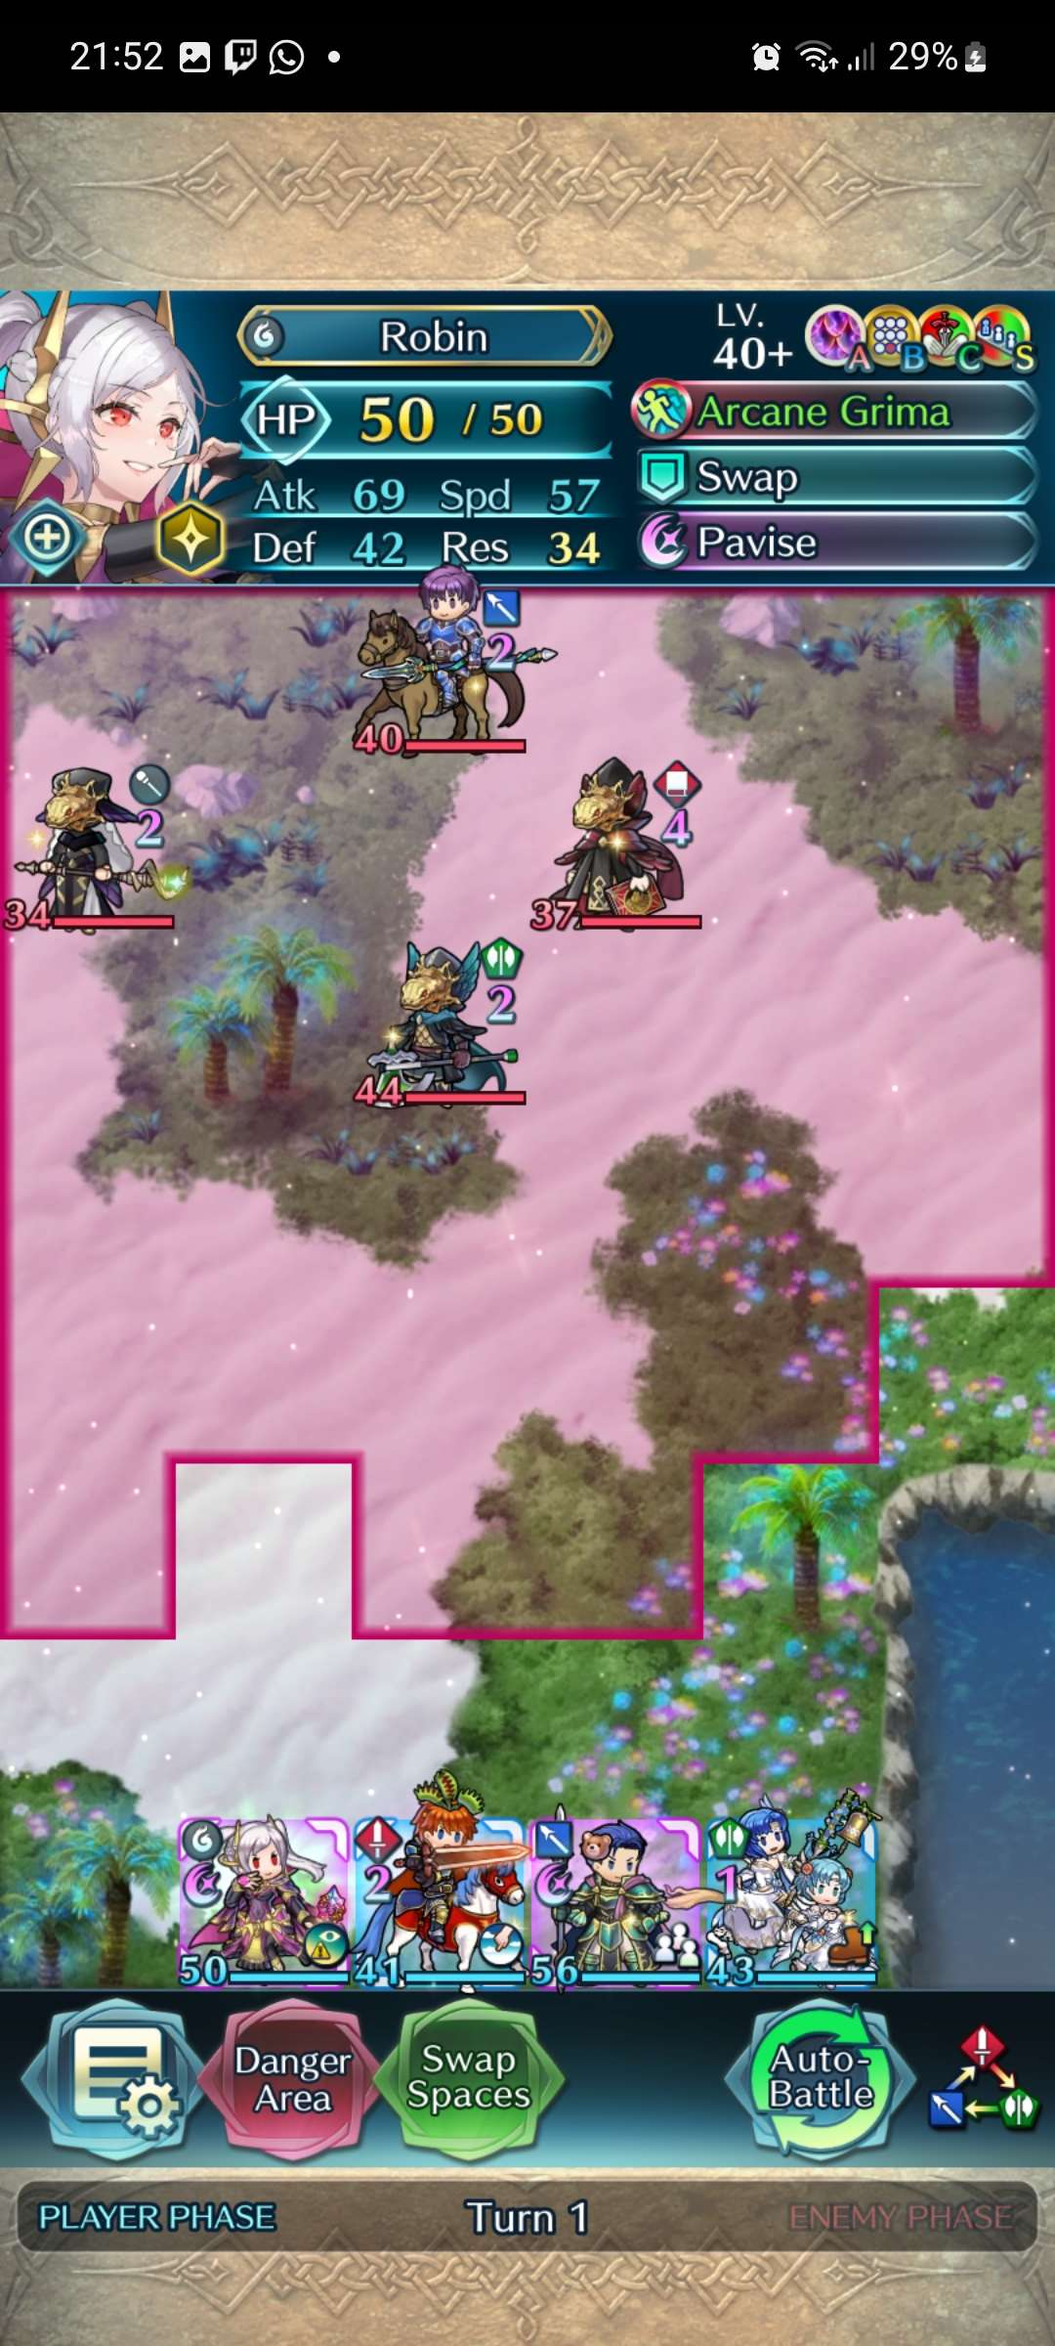
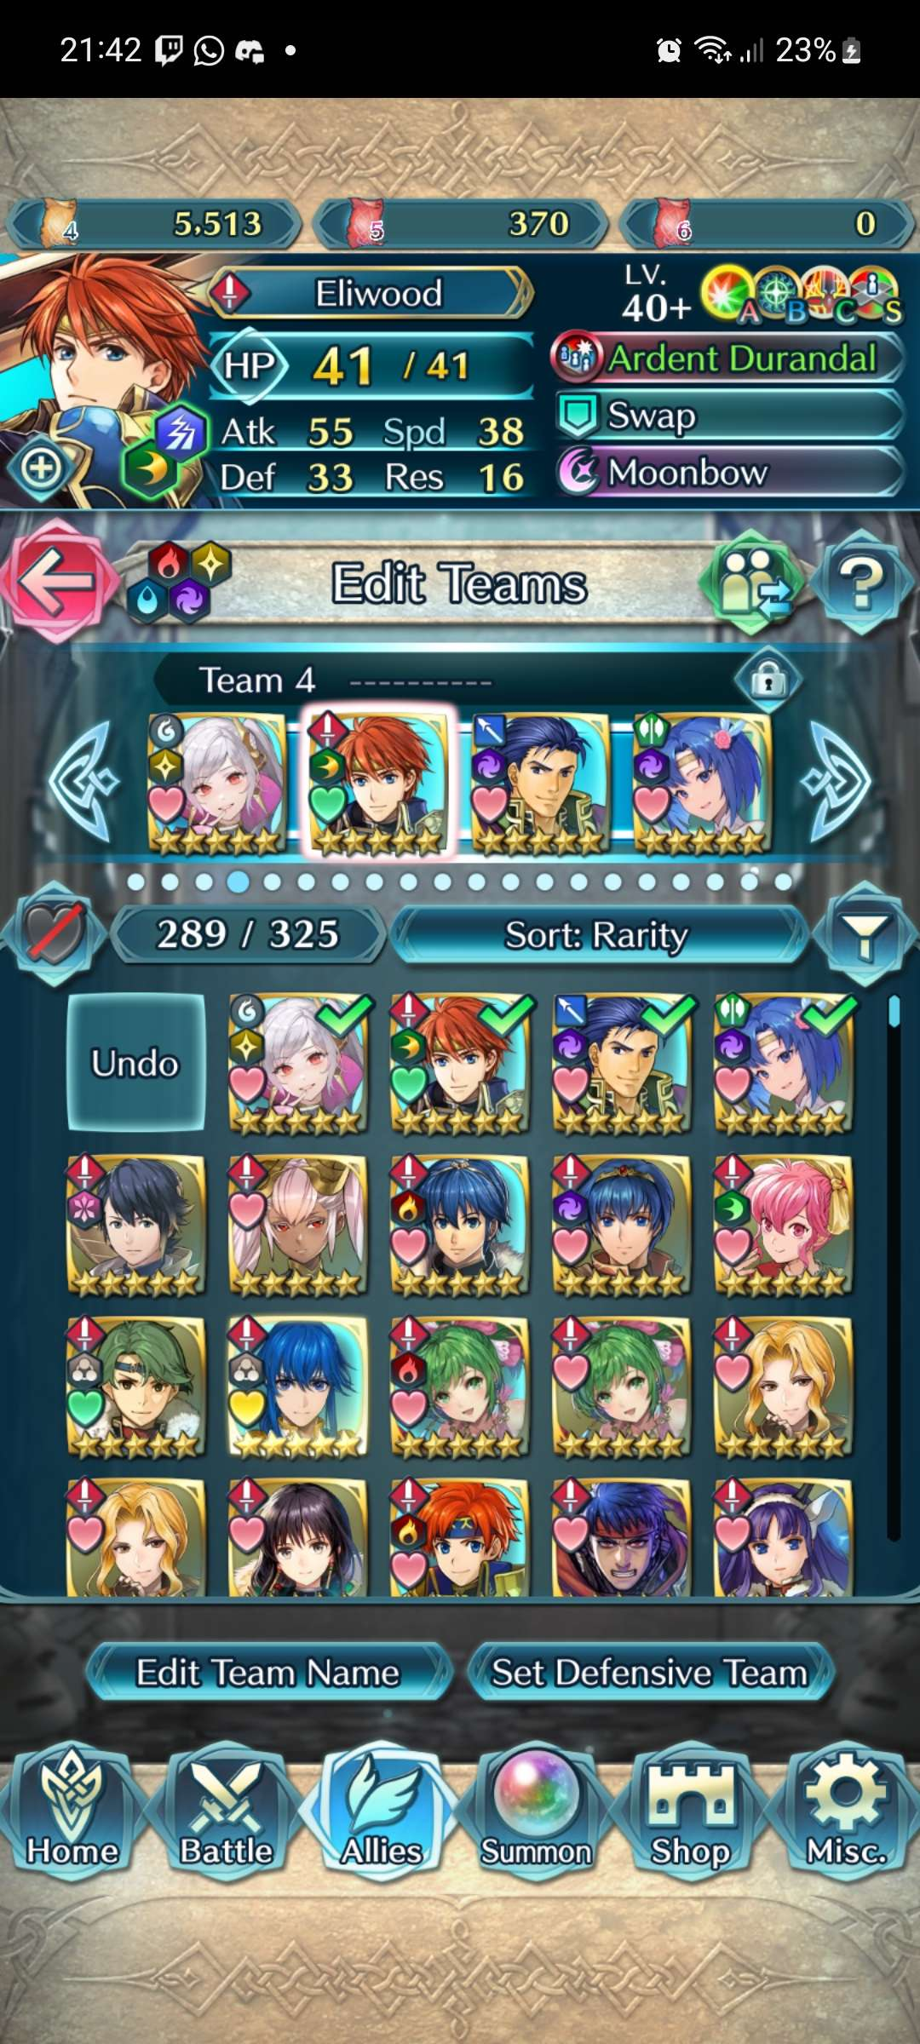


Matching
Icons in the game are used well to communicate between the game’s UI and users, as well as communicate gameplay elements to players
Explanation / Information
Go back –
Add ( Stamina, Dueling Swords, Orbs)
– Filter (heroes)
Arrows to navigate different summoning events
– Sword / Axe / Lance weapon type

Slide 11
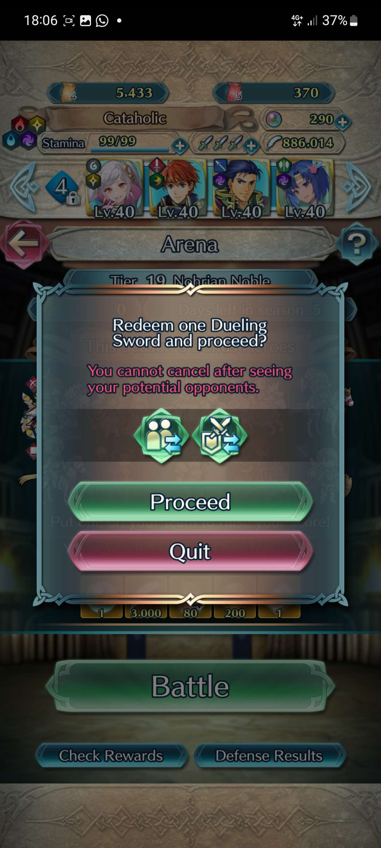

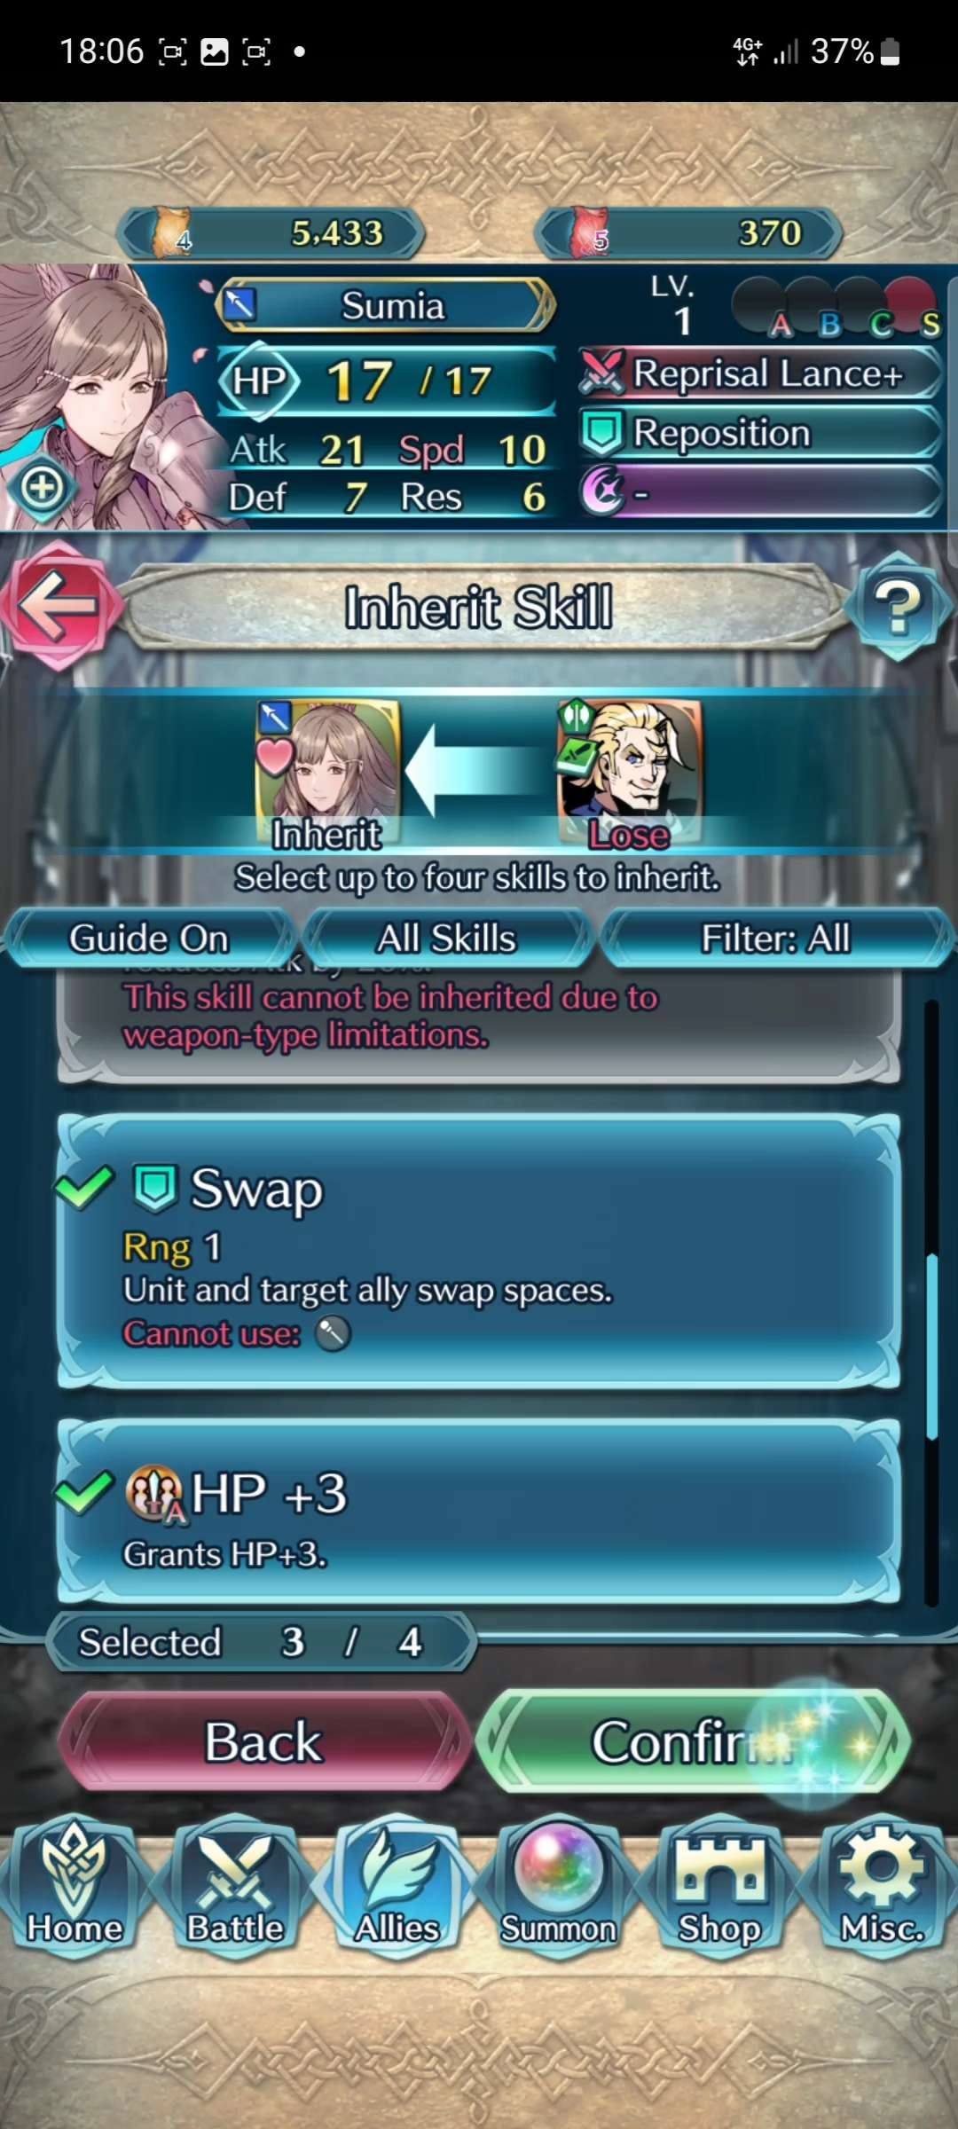
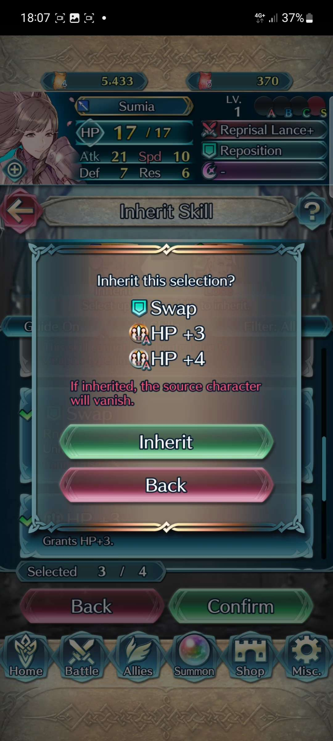
Freedom
The game has a confirmation for almost everything you do
Entering battle (costs resources)
Inheriting skills (permanently loses characters)

Slide 12
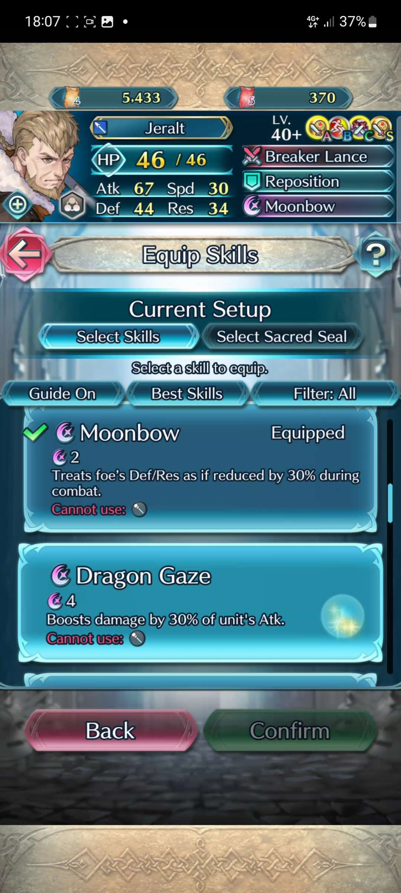
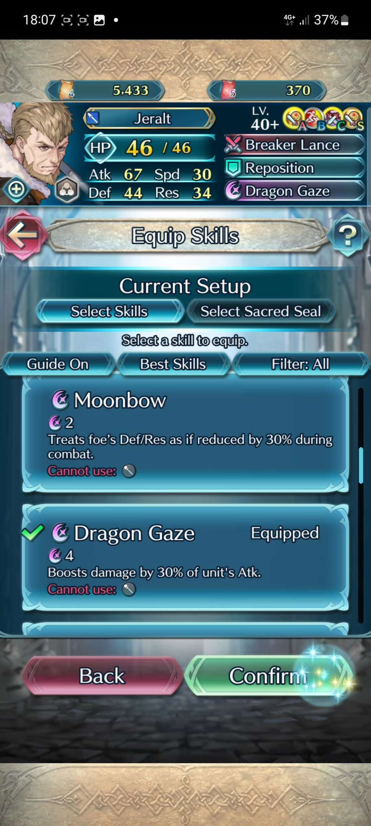
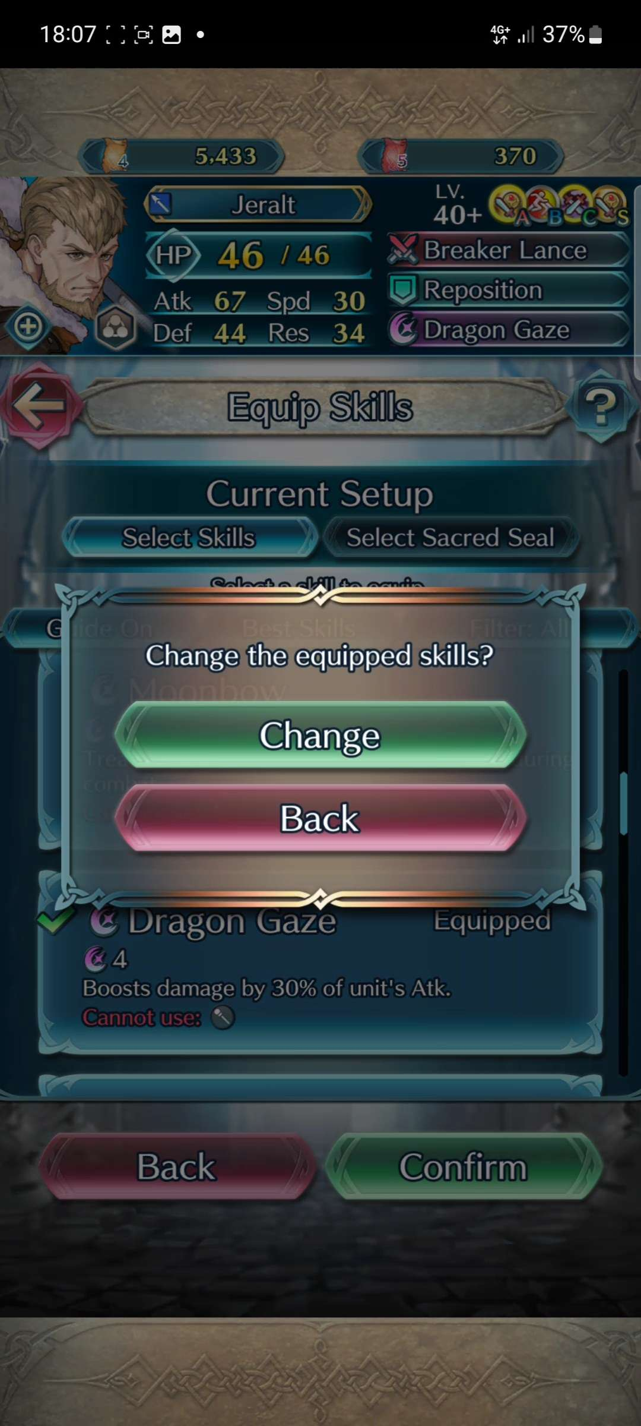
Freedom
Even actions that don't cause any permanent or significant change

Slide 13
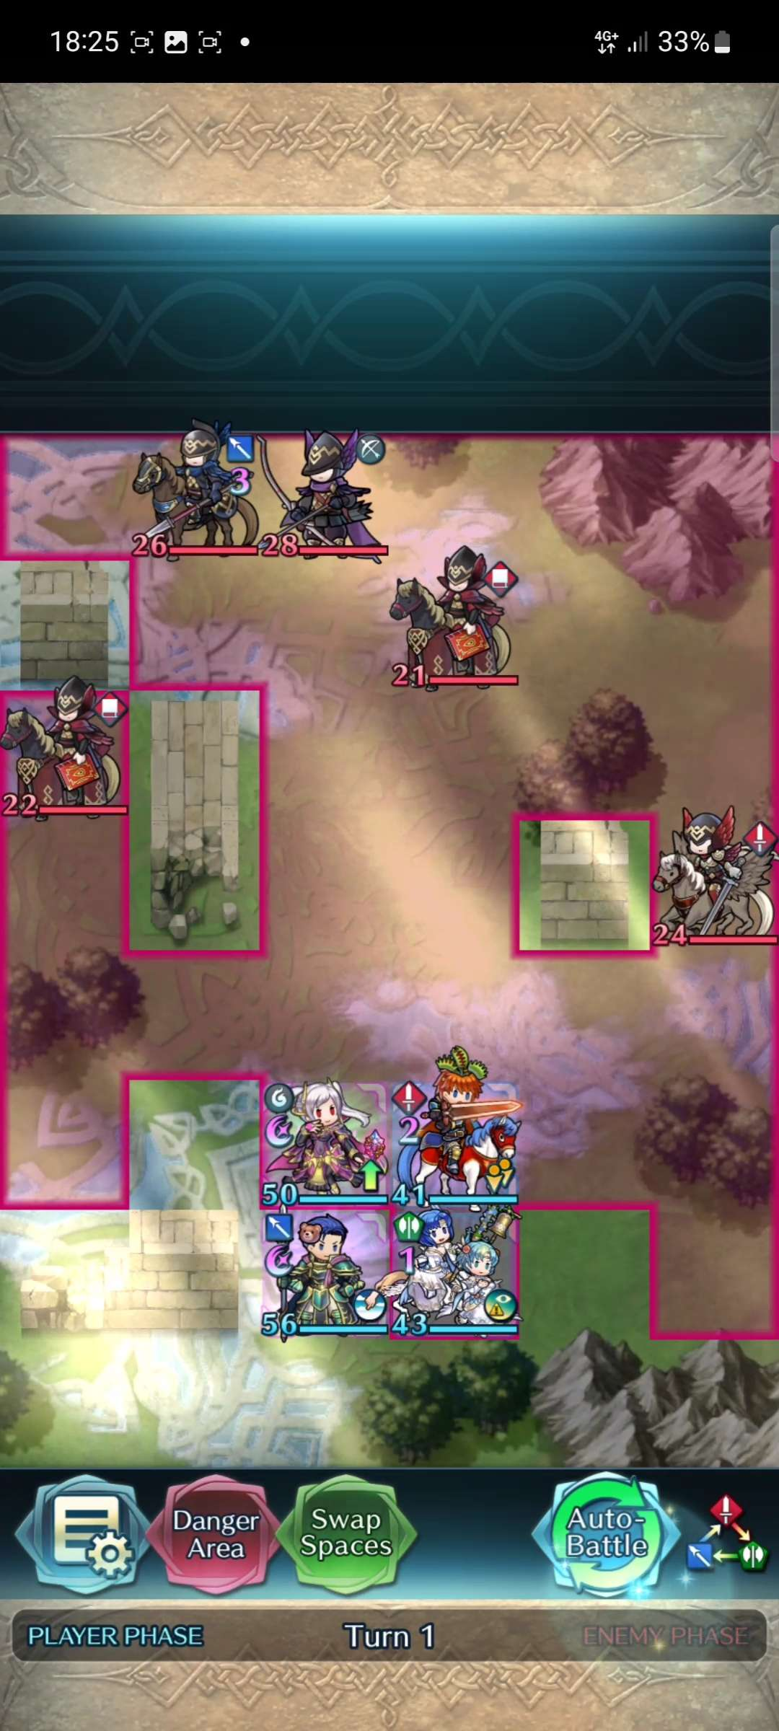
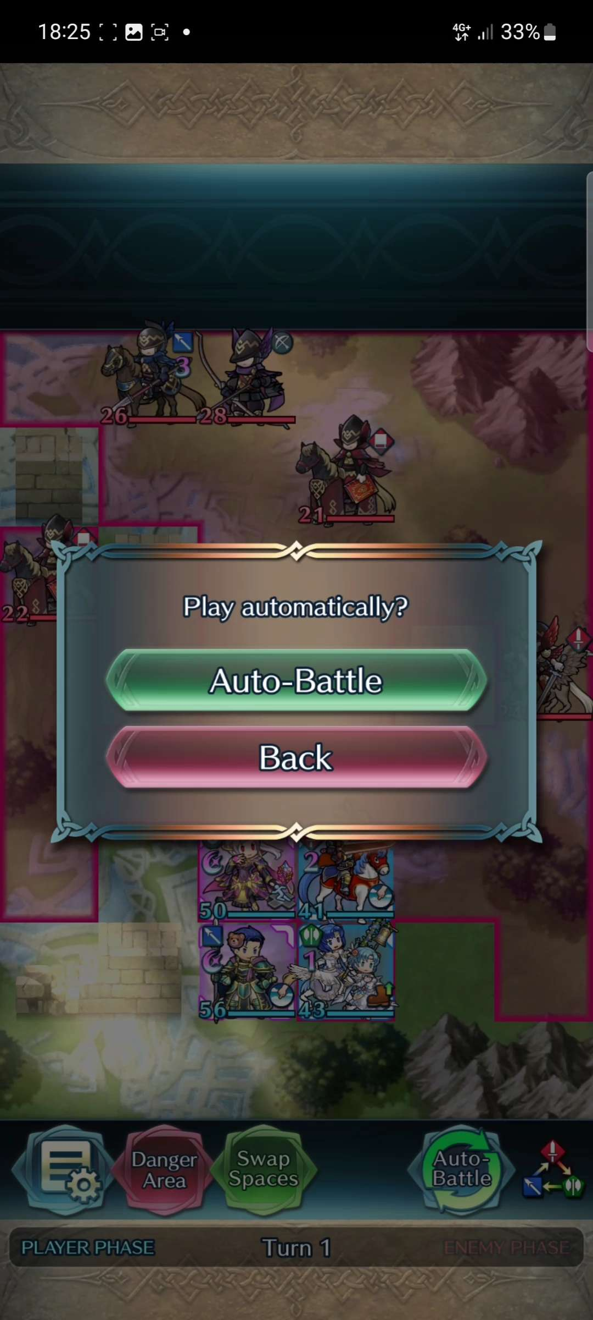
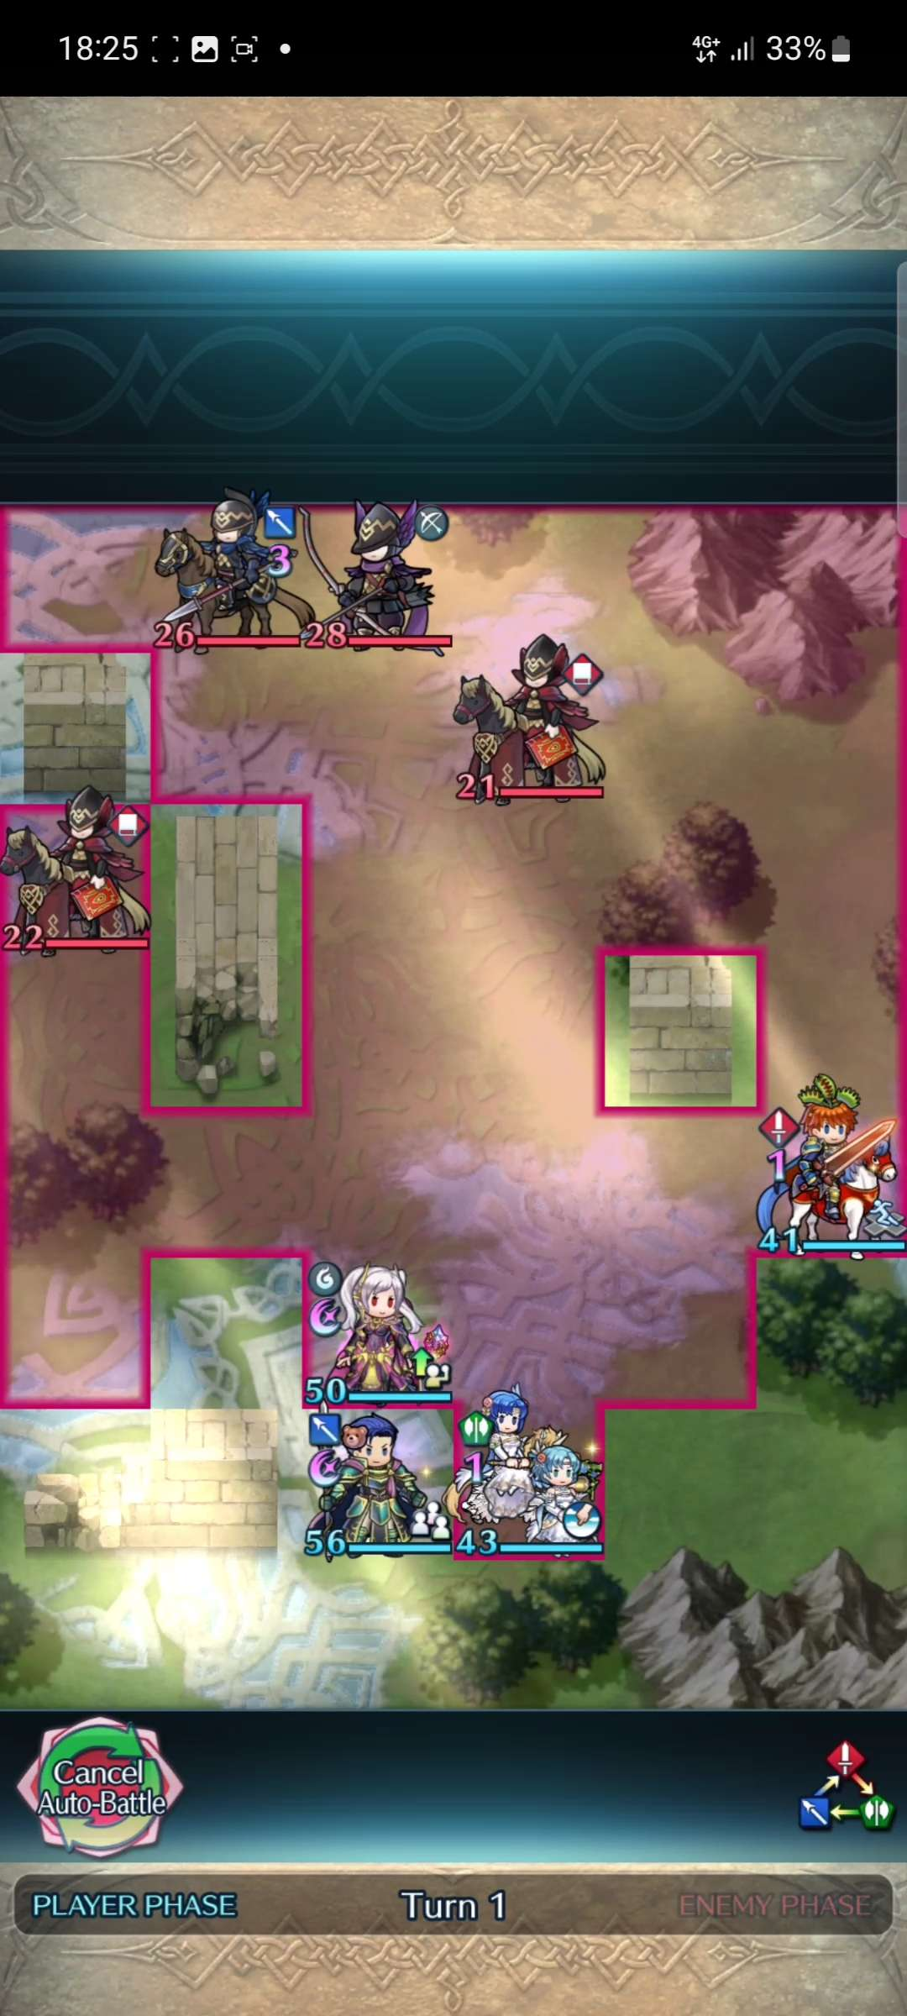

Freedom
You can also stop an on-going action like auto-battle

Slide 14
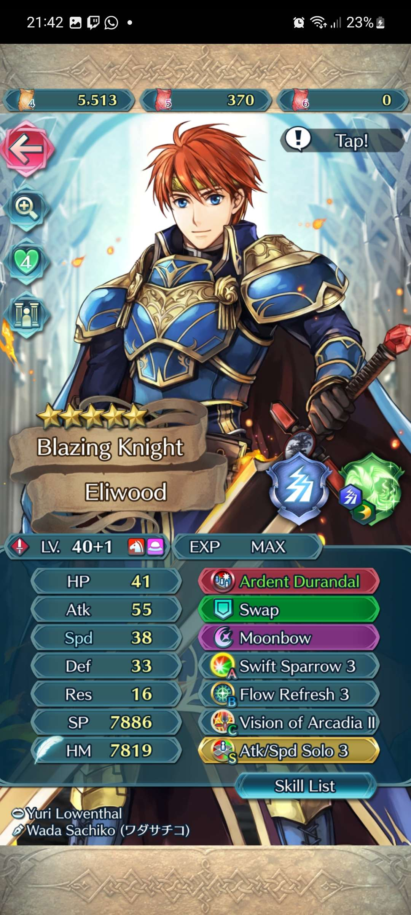


Consistency
The game is very consistent with its styling. Symbols like pluses are used for additional information, red back arrows to return placed on the top left, and confirmations always being the top or right option

Slide 15
Consistency
Top part – has various additional information a player can inspect
The UI as a whole has 3 portions to it, with every game mode adhering to it
Middle part – where gameplay occurs / moving player characters
Bottom part – navigation of various menus

Slide 16
Consistency
Top part – Information on resources
Middle part – Interacting with various objects / menus
Bottom part – navigation of various menus

Slide 17
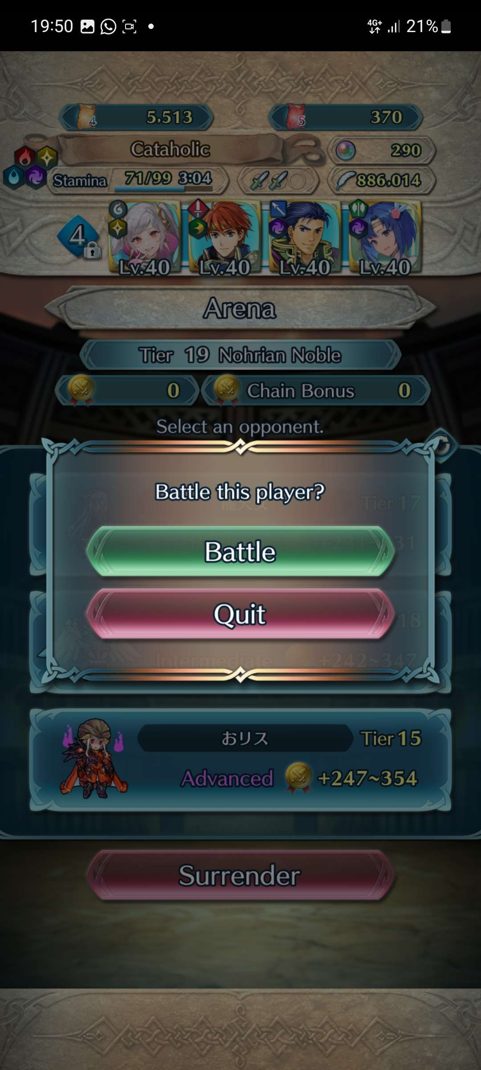
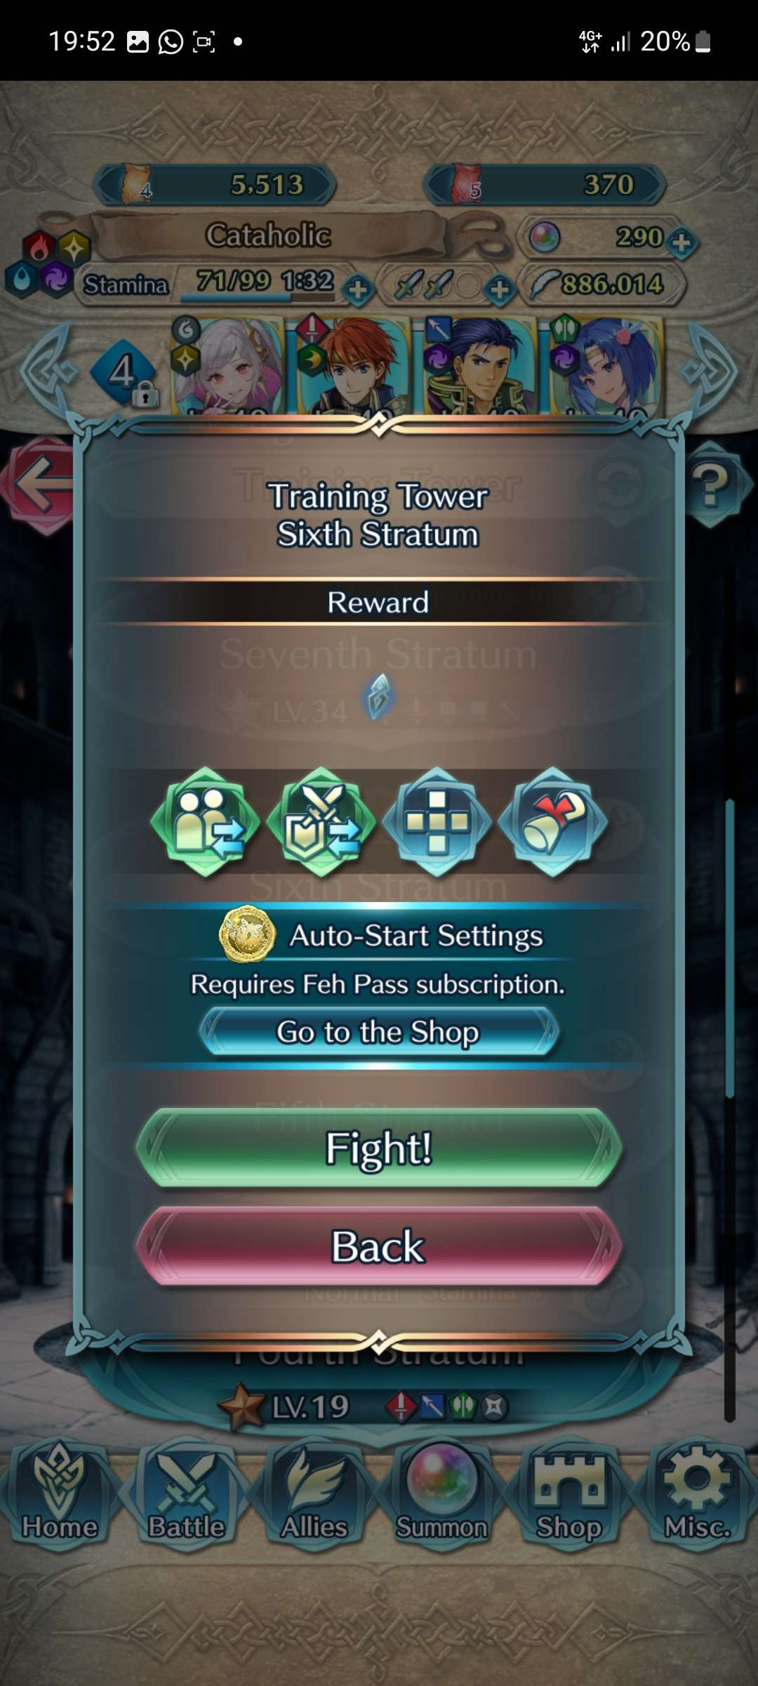
Consistency
It is also consistent with the wording used in the game. For example when you're entering a fight against characters that belong to other players the word "Battle" is used, while "Fight!" is used for every other game map

Slide 18
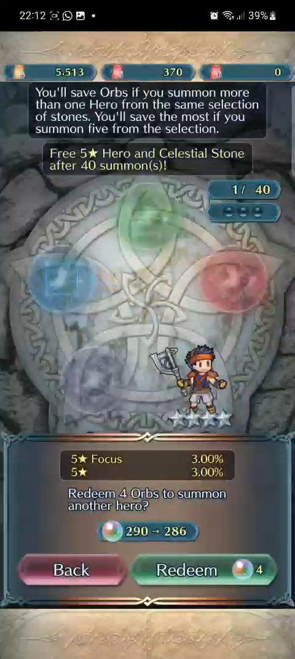
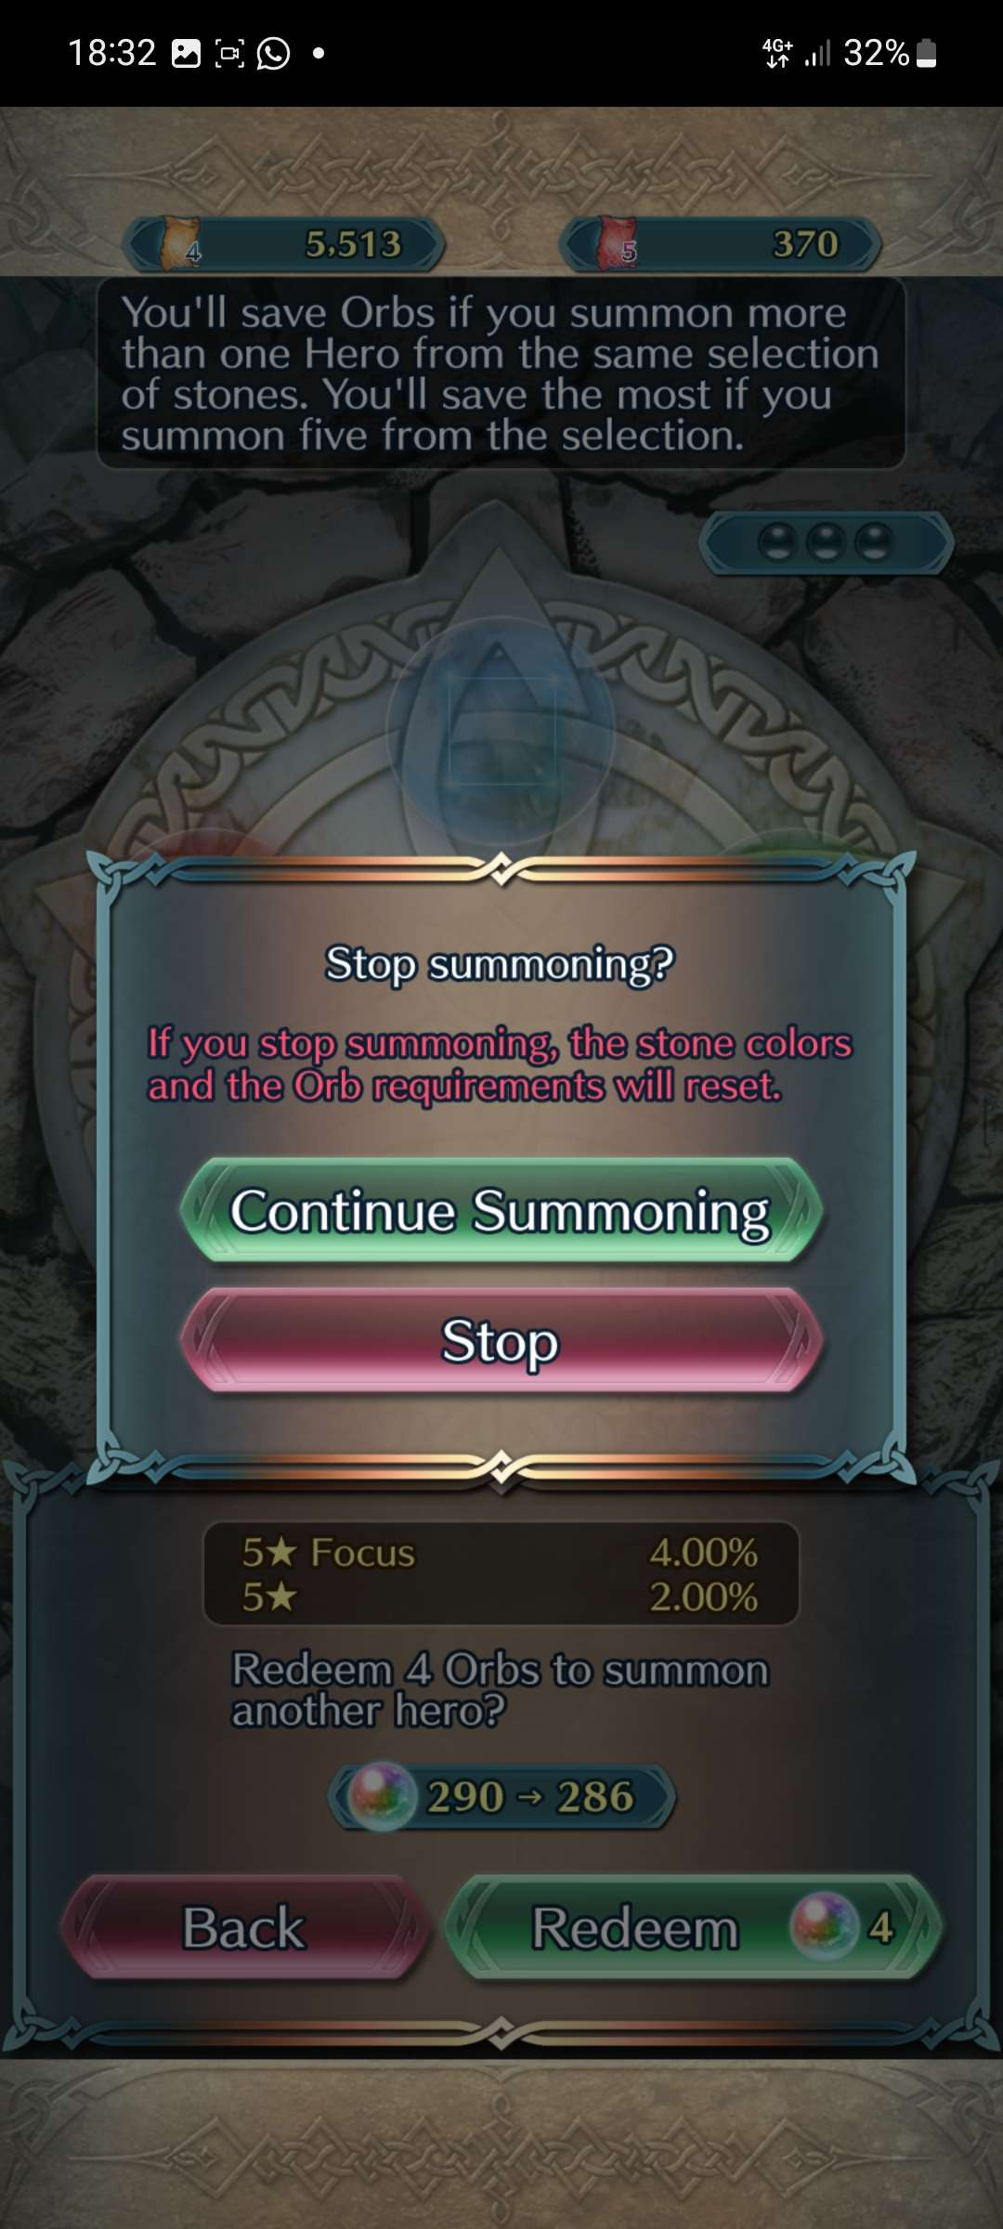

Consistency
One inconsistency is on the summoning screen, where you would usually have to confirm an action, but here it is done without confirming
As well as when you want to exit the summoning screen, the
confirmation and back button swap meaning (not confirming your action, but undoing it)
Very inconsistent with the rest of the game and bad UX...
but this is also where players spend real money and how the developers make most of their money so... ingenious intentionally bad UX?

Slide 19
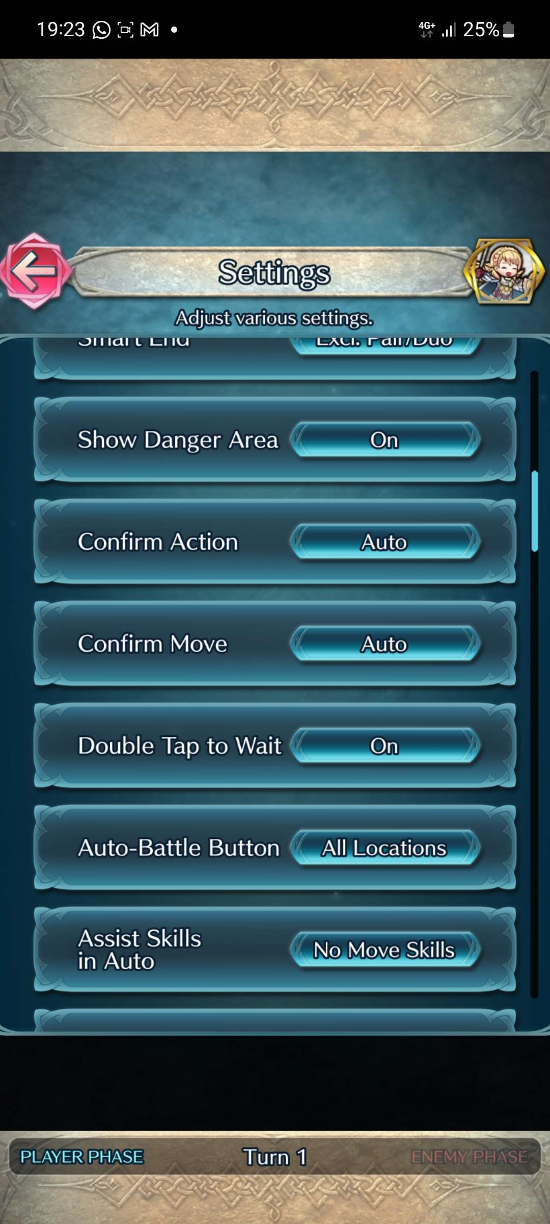
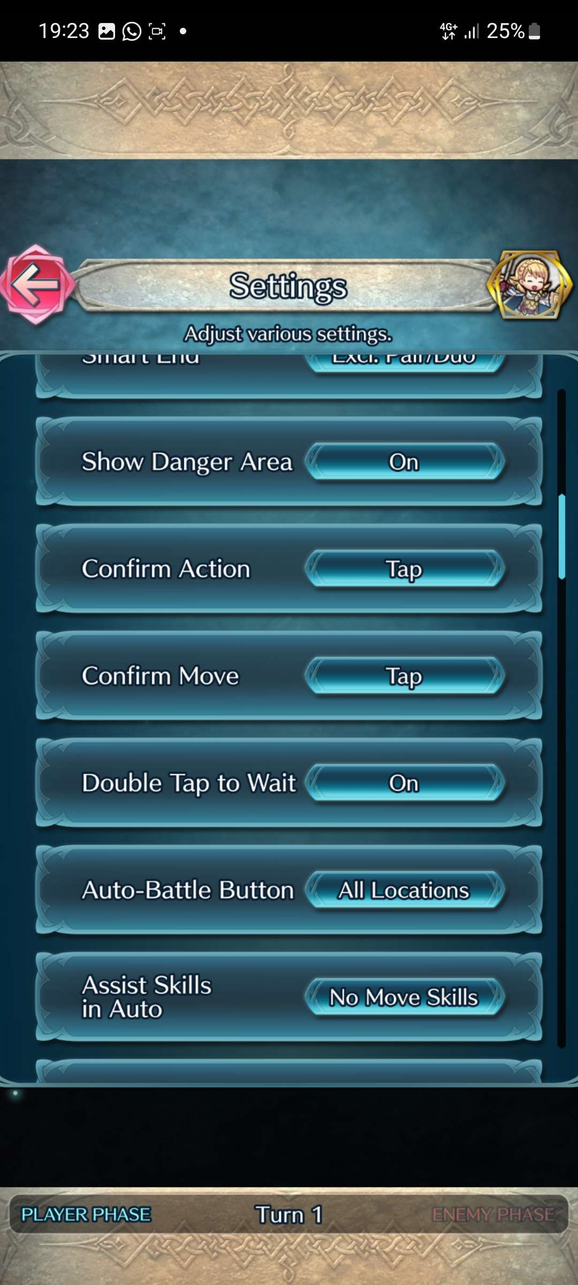
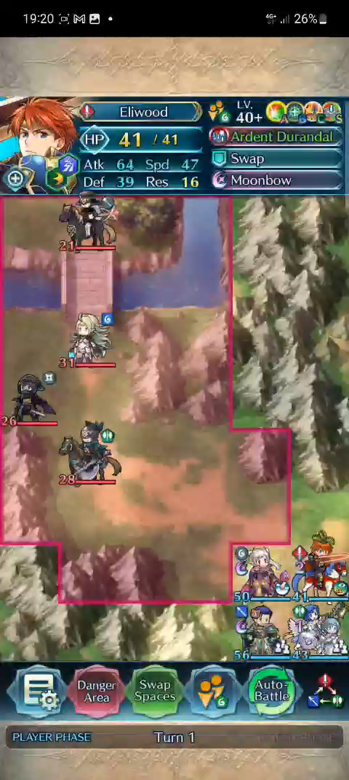
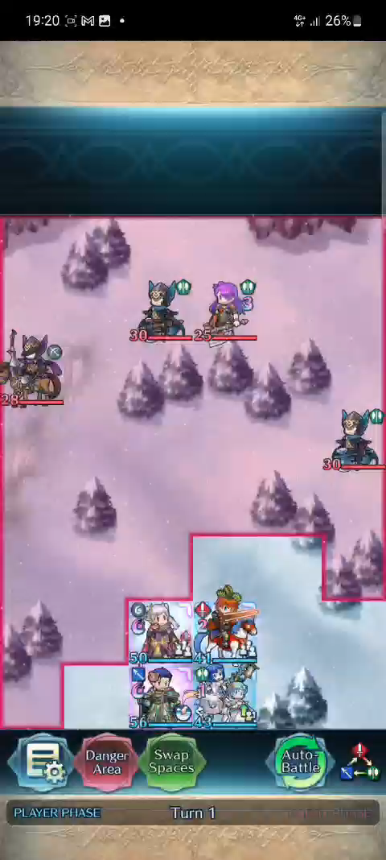
Error Prevention
As mentioned before, almost everything needs confirmation, so errors hardly occur
But even when you're playing the game proper, there is error prevention for your actions! While not on by default, you can select your actions to be confirmed by a tap instead of them being done on a swipe
*click to play video*
*click to play video*

Slide 20
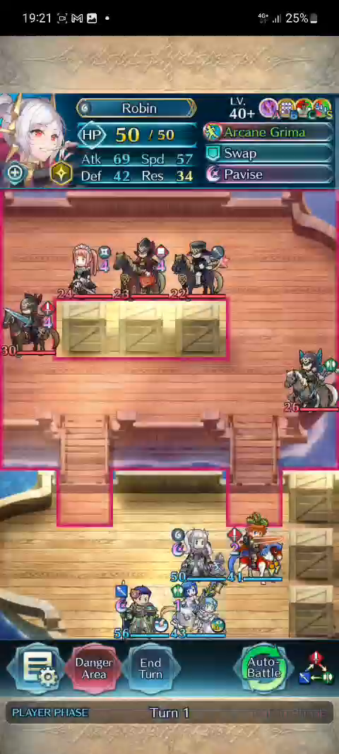
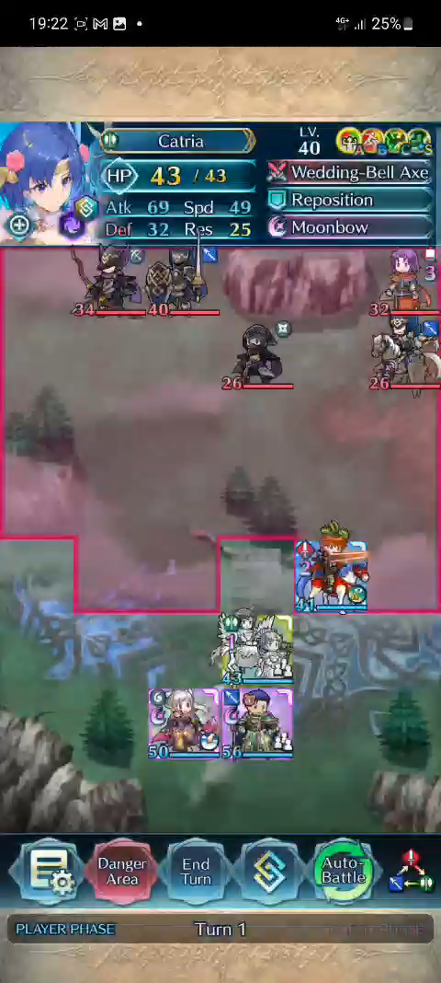
Error Prevention
*click to play video*
*click to play video*

Slide 21
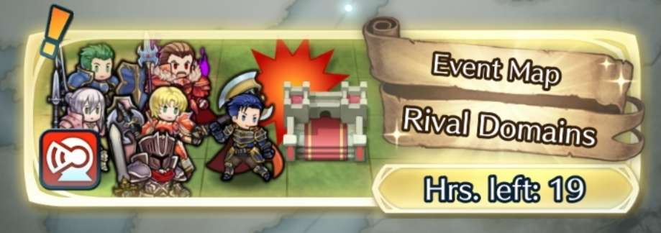
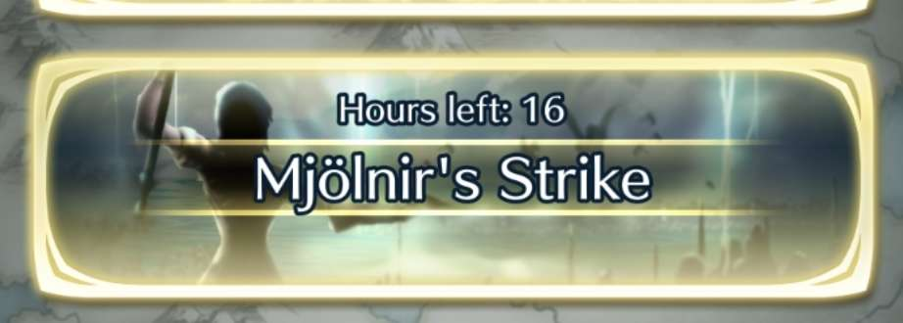
Recognition
Most of the actions/locations in the game are accompanied by an icon, so even if a user doesn't want to read, they can navigate a majority of the game just by recognizing the icons and symbols on screen

Slide 22
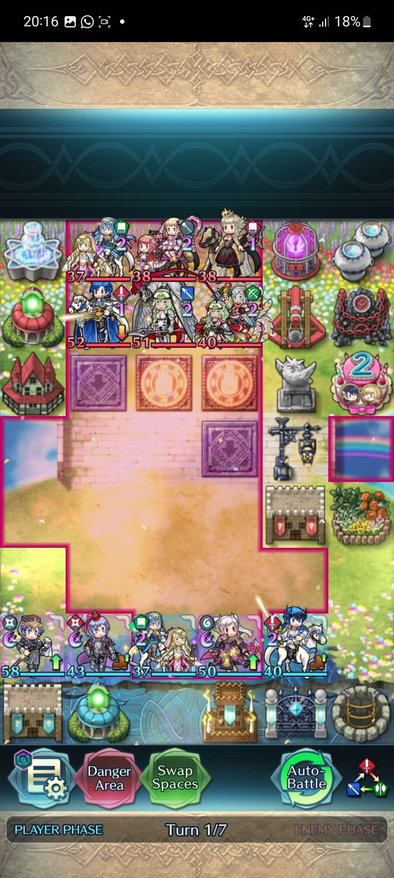
Recognition
Even in the game proper, recognition is used very well. On the bottom right of a game map you always have the "weapon triangle" which helps you learn what weapons are strong against what
As you can see, there are more than just swords, axes and swords being used, but the color coding to red, blue and green helps you recognize fast whether you're at a disadvantage or not

Slide 23
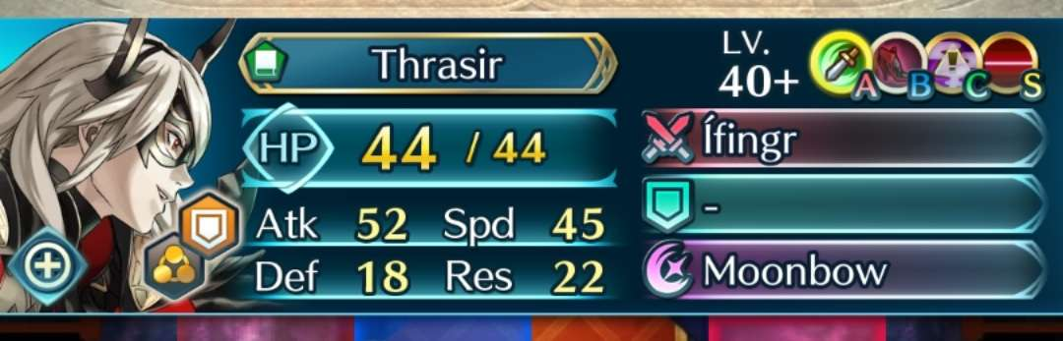
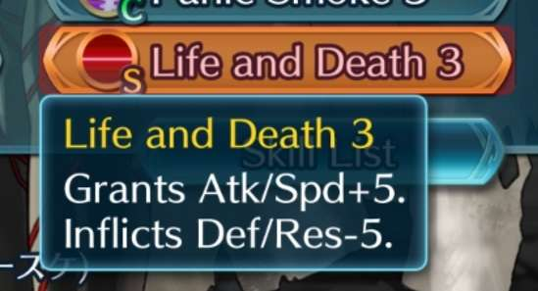
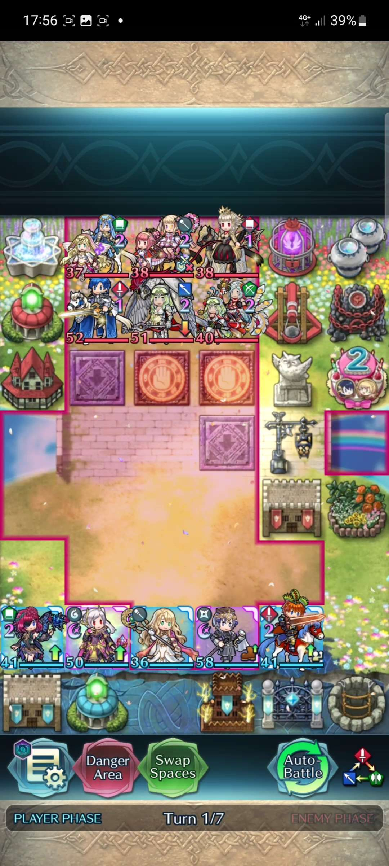
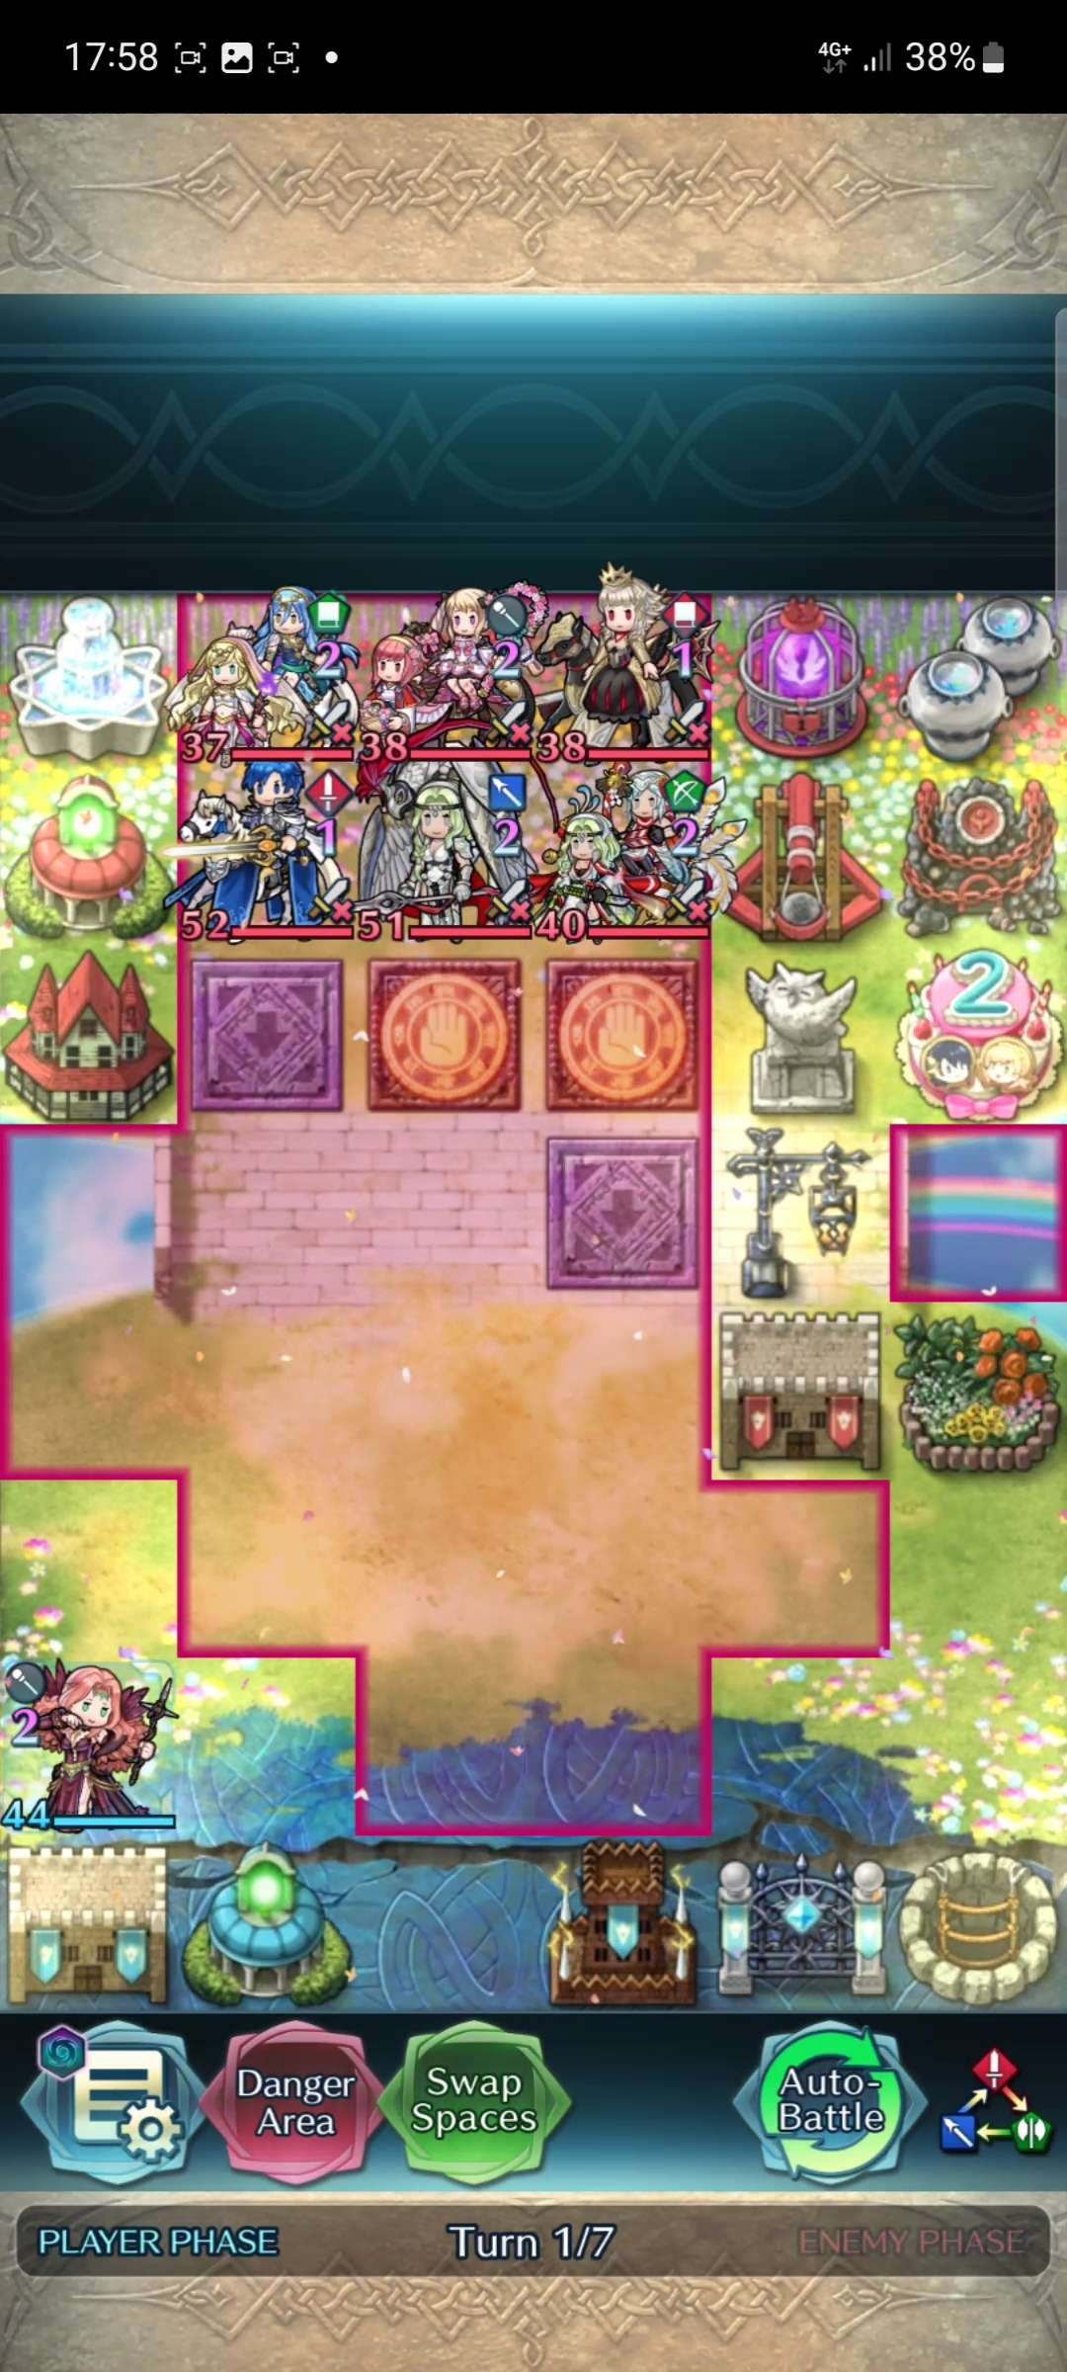
Recognition
The game has various skills characters can equip and you can quickly glance at the top of the screen to see what a skill an enemy has, without having to read the full name
There are also various status effects that have small icons that help you see what effects are active, without having to read lots of text if you already know what the effect does
Debuffed / Weakened
Extra mobility
Cannot counter-attack

Slide 24
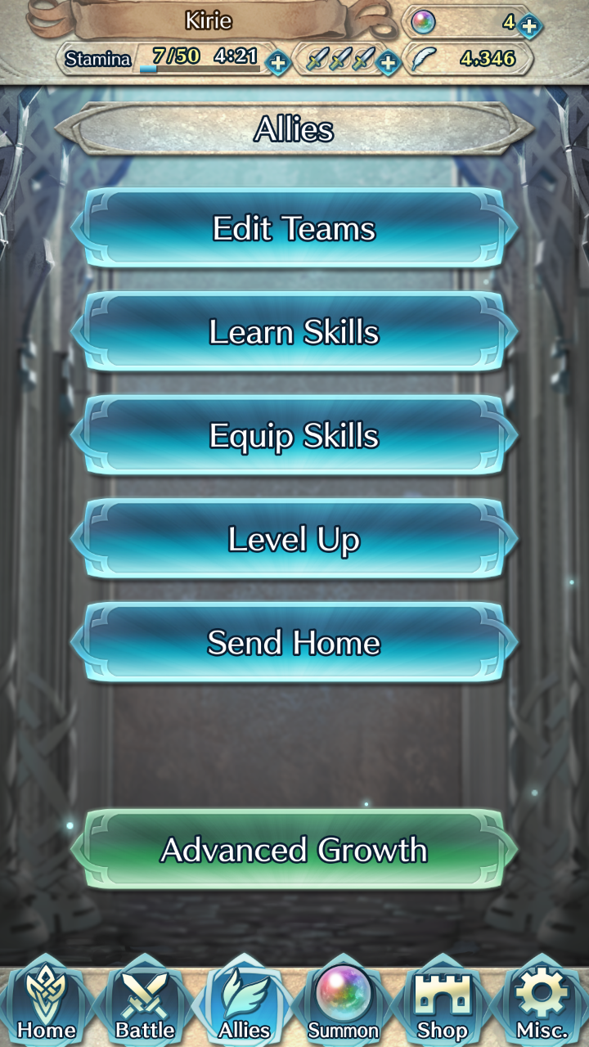
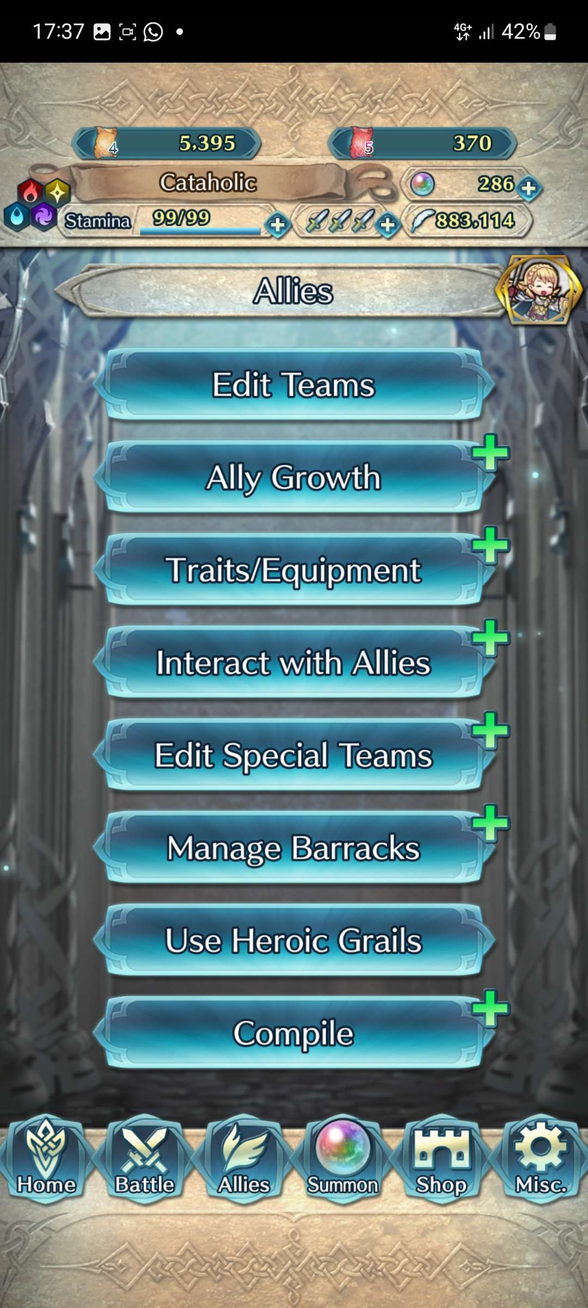


Recognition
Recognition
*OLD allies menu*
*NEW allies menu*
One fall through on the UX of the game however is the allies menu
It has way too many menus within menus and zero icons for them, only text (although there is a green + to indicate that there is more options inside)
Even the developers know this is a problem since players can't find newer features, so they changed the text and color for the buttons to guide players to the new features

Slide 25
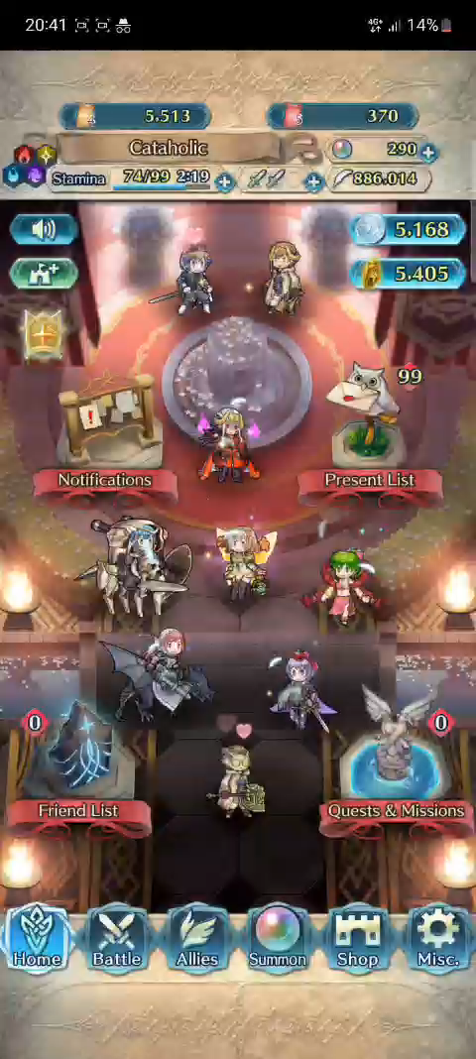

Flexibility
The game is all about customizing your characters, so changing their skills and what party members you have is a big part of the game. Thankfully, you can speed that up! just compare the how many clicks it takes to do these actions
*making a new team and going into battle*
*click to play video*
*click to play video*

Slide 26


Flexibility
it saves you 10-15 seconds worth of clicks, which adds up after a while
*changing skills and going into battle*
*click to play video*
*click to play video*

Slide 27

Aesthetics / Minimalism
When you're in a navigation menu, there is little text and everything is spaced out and very easy to differentiate

Slide 28




Aesthetics / Minimalism
In the game proper, the UI takes about 20% of the total screen, on the top and bottom
If you're not sure what a weapon, skill or some other stat does just by the icon, you can tap it for more information

Slide 29

Aesthetics / Minimalism
Just beware that the game designers win sometimes and you get situations like... this sometimes

Slide 30



Error Recovery
While there isn't many errors in the app, there are instances where they can occur. There is only one error with one option that prompts you to return to the title screen
Other errors have an explanation as to what caused them and why you're prevented from continuing

Slide 31

Aesthetics / Minimalism
While some errors don't really provide an explanation unless you go through a bunch of menus to research yourself, or look it up online

Slide 32




Help / Documentation
In the game, a majority of the screens have additional information you can learn in game when clicking on the ? icon. In it you get some additional information about a game mode, although, its not very informative and its hard and boring to read..

Slide 33




Help / Documentation
But there might also be a "Learn with Shrena" icon which takes you to the games very own guide site, which opens up in-app with a lot more pictures and comic book like dialog sequences that make reading more engaging
While not perfect, it does provide some useful information to newcomers

Slide 34
Results
While I haven’t found many issues, I have compiled a few issues in a table with a severity rating for each
Problem Location | Violated Heuristic | Problem Description | Severity
Various | Matching | Two of the icons used for navigation don’t match the location names | Low
Allies menu | Recognition | Lots of menus within menus that are confusing to navigate | Medium
Summoning Screen | Consistency | Quitting confirmation swapped places, no confirmation for summoning | Medium
Various | Help | Advanced game mechanics are not explained / explained poorly | Medium

Slide 35

Conclusion
Overall, Fire Emblem Heroes has great User Experience along with amazing sound design, with some small problems in regard to explaining more advanced game mechanics
It’s also a great strategy-RPG game for any RPG fan with an Android/iOS device!

